Slide 1
Cloud computing

Slide 2
Introduction Computing is being transformed into a model consisting of services that are commoditized and delivered in a manner similar to utilities such as water, electricity, gas, and telephony. In such a model, users access services based on their requirements, regardless of where the services are hosted. Several computing paradigms, such as grid computing, have promised to deliver this utility computing vision. Cloud computing is the most recent emerging paradigm promising to turn the vision of “computing utilities” into a reality.

Slide 3
Cloud computing at a glance
In 1969, Leonard Kleinrock, one of the chief scientists of the original Advanced Research Projects
Agency Network (ARPANET), which seeded the Internet, said:
As of now, computer networks are still in their infancy, but as they grow up and become sophisti-
cated, we will probably see the spread of ‘computer utilities’ which, like present electric and tele-
phone utilities, will service individual homes and offices across the country.
This vision of computing utilities based on a service-provisioning model anticipated the massive
transformation of the entire computing industry in the 21st century, whereby computing services
will be readily available on demand, just as other utility services such as water, electricity, tele-
phone, and gas are available in today’s society. Similarly, users (consumers) need to pay providers
only when they access the computing services. In addition, consumers no longer need to invest
heavily or encounter difficulties in building and maintaining complex IT infrastructure.
In such a model, users access services based on their requirements without regard to where the
services are hosted. This model has been referred to as utility computing or, recently (since 2007),
as cloud computing. The latter term often denotes the infrastructure as a “cloud” from which busi-
nesses and users can access applications as services from anywhere in the world and on demand.
Hence, cloud computing can be classified as a new paradigm for the dynamic provisioning of com-
puting services supported by state-of-the-art data centers employing virtualization technologies for
consolidation and effective utilization of resources.

Slide 4
The vision of cloud computing
Cloud computing allows anyone with a credit card to provision virtual hardware, runtime environ-
ments, and services. These are used for as long as needed, with no up-front commitments required.
The entire stack of a computing system is transformed into a collection of utilities, which can be
provisioned and composed together to deploy systems in hours rather than days and with virtually
no maintenance costs. This opportunity, initially met with skepticism, has now become a practice
across several application domains and business sectors (see Figure 1.1).

Slide 5
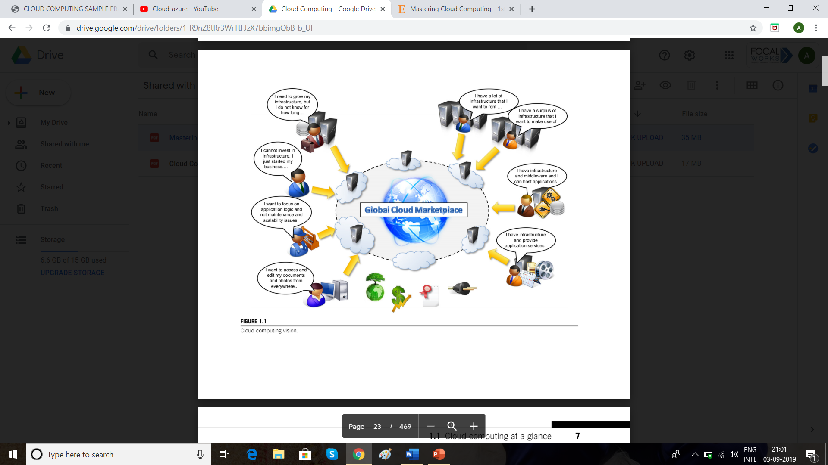

Slide 6
Defining a cloud
Cloud computing has become a popular buzzword; it has been widely used to refer to different technologies, services, and concepts. It is often associated with virtualized infrastructure or hard-ware on demand, utility computing, IT outsourcing, platform and software as a service, and many other things that now are the focus of the IT industry. Figure 1.2 depicts the plethora of different notions included in current definitions of cloud computing. The term cloud has historically been used in the telecommunications industry as an abstraction of
the network in system diagrams. It then became the symbol of the most popular computer network: the Internet. This meaning also applies to cloud computing, which refers to an Internet-centric way of computing.

Slide 7
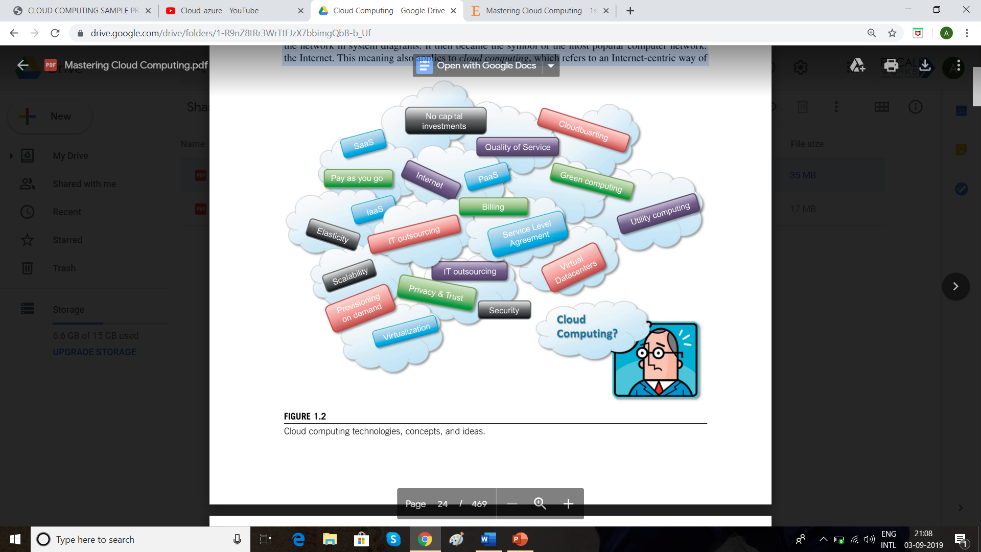

Slide 8
Cloud computing refers to both the applications delivered as services over the Internet and the
hardware and system software in the data centers that provide those services.
Cloud computing is a model for enabling ubiquitous, convenient, on-demand network access to a
shared pool of configurable computing resources (e.g., networks, servers, storage, applications,
and services) that can be rapidly provisioned and released with minimal management effort or
service provider interaction.
we can define three criteria to discriminate whether a service is delivered in the cloud computing
style:
• The service is accessible via a Web browser (nonproprietary) or a Web services application
programming interface (API).
• Zero capital expenditure is necessary to get started.
• You pay only for what you use as you use it.
Even though many cloud computing services are freely available for single users, enterprise-
class services are delivered according a specific pricing scheme. In this case users subscribe to the service and establish with the service provider a service-level agreement (SLA) defining the quality-of-service parameters under which the service is delivered. The utility-oriented nature of
cloud computing is clearly expressed by Buyya et al.
A cloud is a type of parallel and distributed system consisting of a collection of interconnected
and virtualized computers that are dynamically provisioned and presented as one or more unified
computing resources based on service-level agreements established through negotiation between
the service provider and consumers.

Slide 9
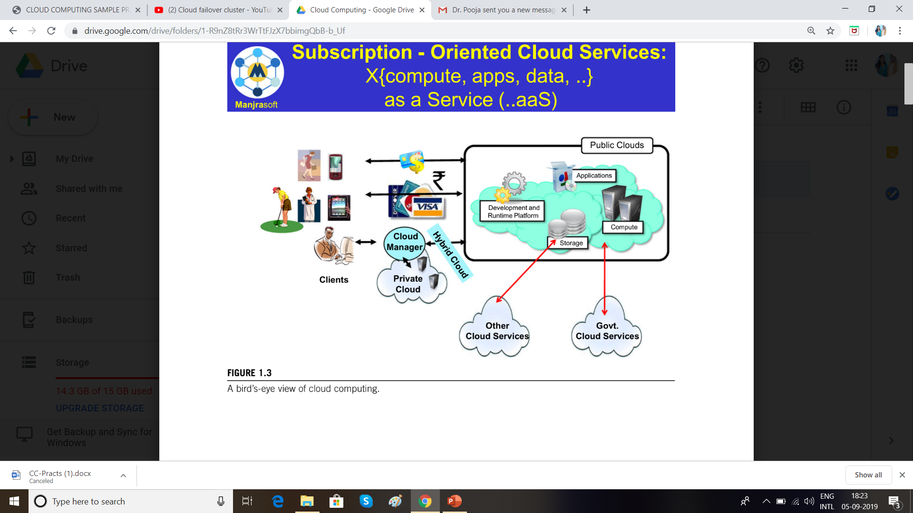
The same concept of IT services on demand—whether computing power, storage, or runtime environments for applications—on a pay-as-you-go basis accommodates these four different scenarios. Cloud computing does not only contribute with the opportunity of easily accessing IT services on demand, it also introduces a new way of thinking about IT services and resources: as utilities. A bird’s-eye view of a cloud computing environment is shown in Figure 1.3.

Slide 10
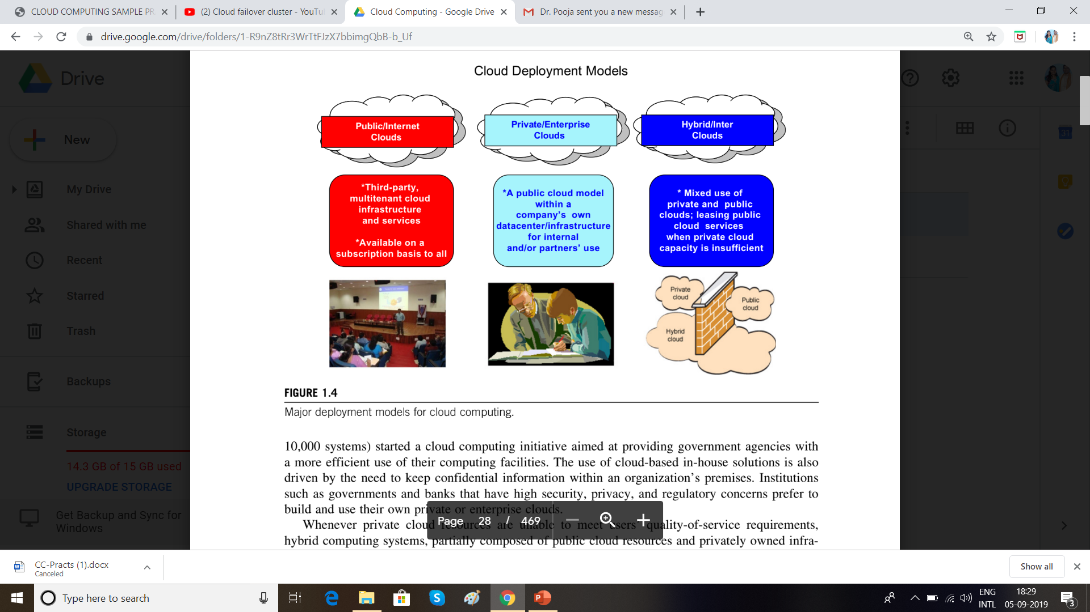
The three major models for deploying and accessing cloud computing environments are public clouds, private/enterprise clouds, and hybrid clouds (see Figure 1.4). Public clouds are the most common deployment models in which necessary IT infrastructure (e.g., virtualized datacenters) is established by a third-party service provider that makes it available to any consumer on a subscription basis. Such clouds are appealing to users because they allow users to quickly leverage compute, storage, and application services. In this environment, users’ data and applications are deployed on cloud datacenters on the vendor’s premises.

Slide 11
The cloud computing reference model
A fundamental characteristic of cloud computing is the capability to deliver, on demand, a variety of IT services that are quite diverse from each other. This variety creates different perceptions of what cloud computing is among users. Despite this lack of uniformity, it is possible to classify cloud computing services offerings into three major categories: Infrastructure-as-a-Service (IaaS), Platform-as-a-Service (PaaS), and Software-as-a-Service (SaaS). These categories are related to each other as described in Figure 1.5, which provides an organic view of cloud computing. We refer to this diagram as the Cloud Computing Reference Model, and we will use it throughout the book to explain the technologies and introduce the relevant research on this phenomenon. The model organizes the wide range of cloud computing services into a layered view that walks the computing stack from bottom to top.

Slide 12
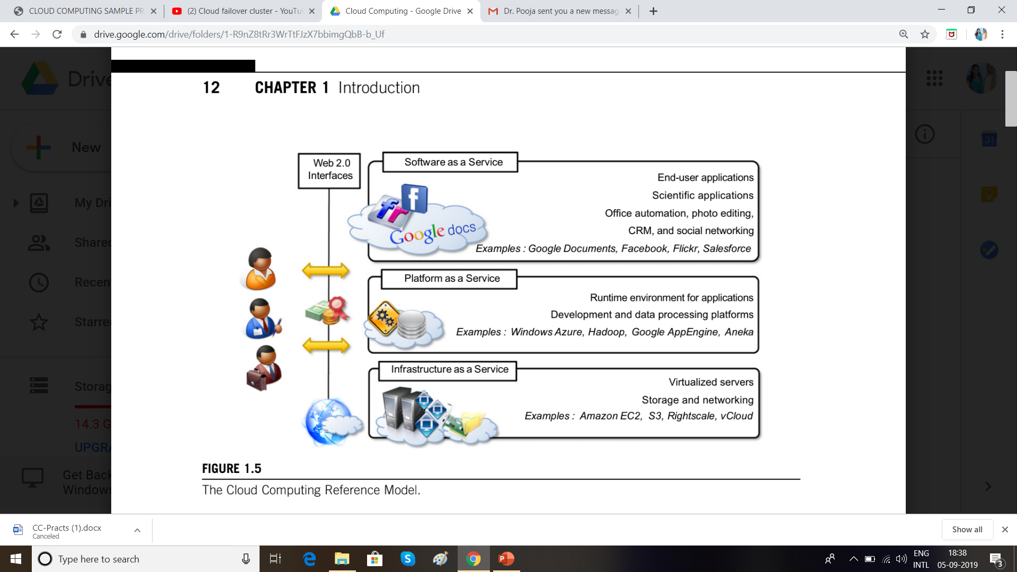

Slide 13
Characteristics and benefits
Cloud computing has some interesting characteristics that bring benefits to both cloud service con-
sumers (CSCs) and cloud service providers (CSPs). These characteristics are:
• No up-front commitments
• On-demand access
• Nice pricing
• Simplified application acceleration and scalability
• Efficient resource allocation
• Energy efficiency
• Seamless creation and use of third-party services
The most evident benefit from the use of cloud computing systems and technologies is the
increased economical return due to the reduced maintenance costs and operational costs related to
IT software and infrastructure. This is mainly because IT assets, namely software and infrastructure,
are turned into utility costs, which are paid for as long as they are used, not paid for up front.
Capital costs are costs associated with assets that need to be paid in advance to start a business
activity.

Slide 14
Historical developments
The idea of renting computing services by leveraging large distributed computing facilities has been around for long time. It dates back to the days of the mainframes in the early 1950s. From there on, technology has evolved and been refined. This process has created a series of favourable conditions for the realization of cloud computing. Figure 1.6 provides an overview of the evolution of the distributed computing technologies that have influenced cloud computing. In tracking the historical evolution, we briefly review five core technologies that played an important role in the realization of cloud computing. These technologies are distributed systems, virtualization, Web 2.0, service orientation, and utility computing.

Slide 15
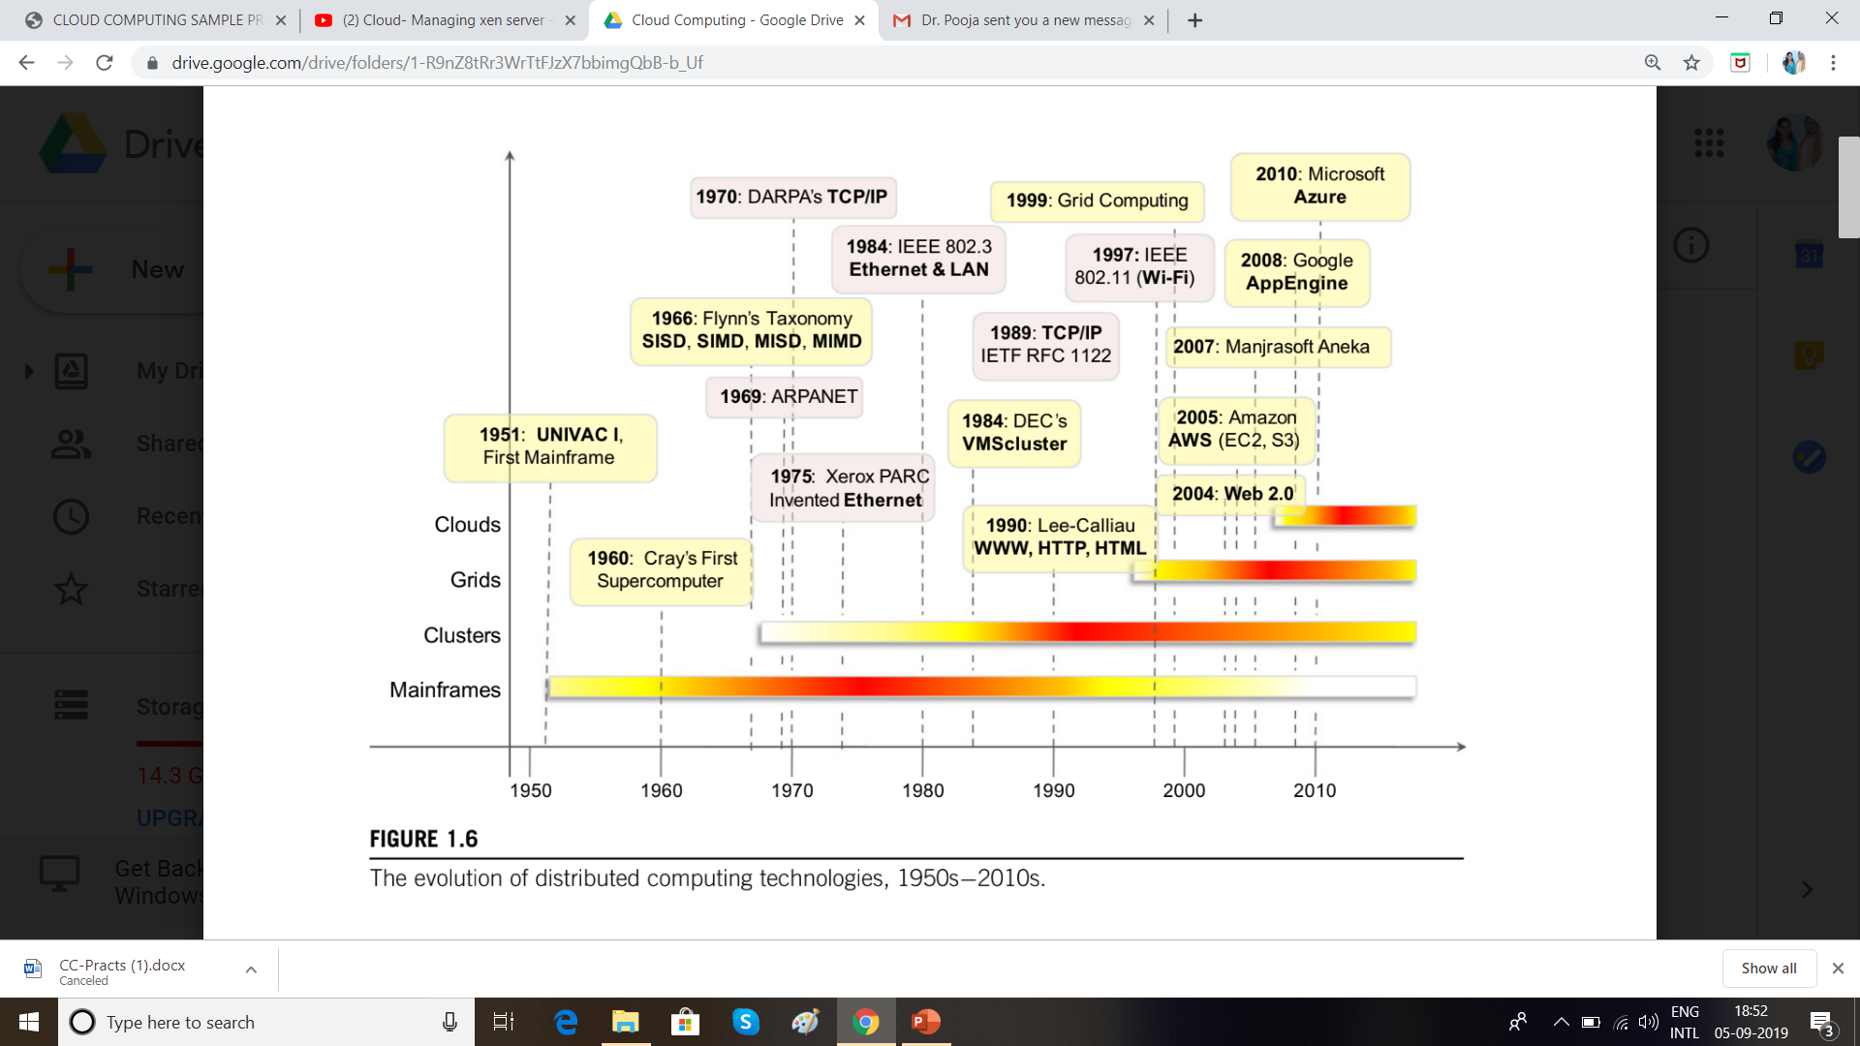

Slide 16
Distributed systems often exhibit other properties such as heterogeneity, openness, scalability,
transparency, concurrency, continuous availability, and independent failures. To some extent these
also characterize clouds, especially in the context of scalability, concurrency, and continuous
availability.
Three major milestones have led to cloud computing: mainframe computing, cluster computing,
and grid computing.
Mainframes :- These were the first examples of large computational facilities leveraging multiple
processing units. Mainframes were powerful, highly reliable computers specialized for large data movement and massive input/output (I/O) operations. They were mostly used by large
organizations for bulk data processing tasks such as online transactions, enterprise resource
planning, and other operations involving the processing of significant amounts of data. Even
though mainframes cannot be considered distributed systems, they offered large computational
power by using multiple processors, which were presented as a single entity to users. One of the
most attractive features of mainframes was the ability to be highly reliable computers that were
“always on” and capable of tolerating failures transparently. No system shutdown was required
to replace failed components, and the system could work without interruption. Batch processing
was the main application of mainframes. Now their popularity and deployments have reduced,
but evolved versions of such systems are still in use for transaction processing (such as online
banking, airline ticket booking, supermarket and telcos, and government services).

Slide 17
Clusters: Cluster computing started as a low-cost alternative to the use of mainframes and
supercomputers. The technology advancement that created faster and more powerful
mainframes and supercomputers eventually generated .
These machines could then be connected by a high-bandwidth network and controlled by specific software tools that manage them as a single system.
Starting in the 1980s, clusters become the standard technology for parallel
and high-performance computing.
Built by commodity machines, they were cheaper than mainframes and made high-performance computing available to a large number of groups, including universities and small research labs. Cluster technology contributed considerably to the evolution of tools and frameworks for distributed computing, including Condor, Parallel Virtual Machine (PVM), and Message Passing Interface (MPI) 4 One of the attractive features of clusters was that the computational power of commodity machines could be leveraged to solve problems that were previously manageable only on expensive
supercomputers. Moreover, clusters could be easily extended if more computational power was required.

Slide 18
Grids:- appeared in the early 1990s as an evolution of cluster computing.
In an analogy to the power grid, grid computing proposed a new approach to access large
computational power, huge storage facilities, and a variety of services.
Users can “consume” resources in the same way as they use other utilities such as power, gas, and water.
Grids initially developed as aggregations of geographically dispersed clusters by means of Internet
connections. These clusters belonged to different organizations, and arrangements were made
among them to share the computational power.
Different from a “large cluster,” a computing grid was a dynamic aggregation of heterogeneous computing nodes, and its scale was nationwide or even worldwide.
Several developments made possible the diffusion of computing grids:
(a) clusters became quite common resources;
(b) they were often underutilized;
(c) New problems were requiring computational power that went beyond the capability of single
clusters; and
(d) the improvements in networking and the diffusion of the Internet made
possible long-distance, high-bandwidth connectivity. All these elements led to the development
of grids, which now serve a multitude of users across the world.

Slide 19
Building Cloud Computing Environments
The creation of cloud computing environments encompasses both the development of applications and systems that leverage cloud computing solutions and the creation of frameworks, platforms,and infrastructures delivering cloud computing services.
Application development
Infrastructure and system development
Computing platforms and technologies
Amazon web services (AWS)
Google AppEngine
Microsoft Azure
Hadoop
Force.com and Salesforce.com
Manjrasoft Aneka

Slide 20
CHAPTER 2
Principles of Parallel and Distributed Computing

Slide 21
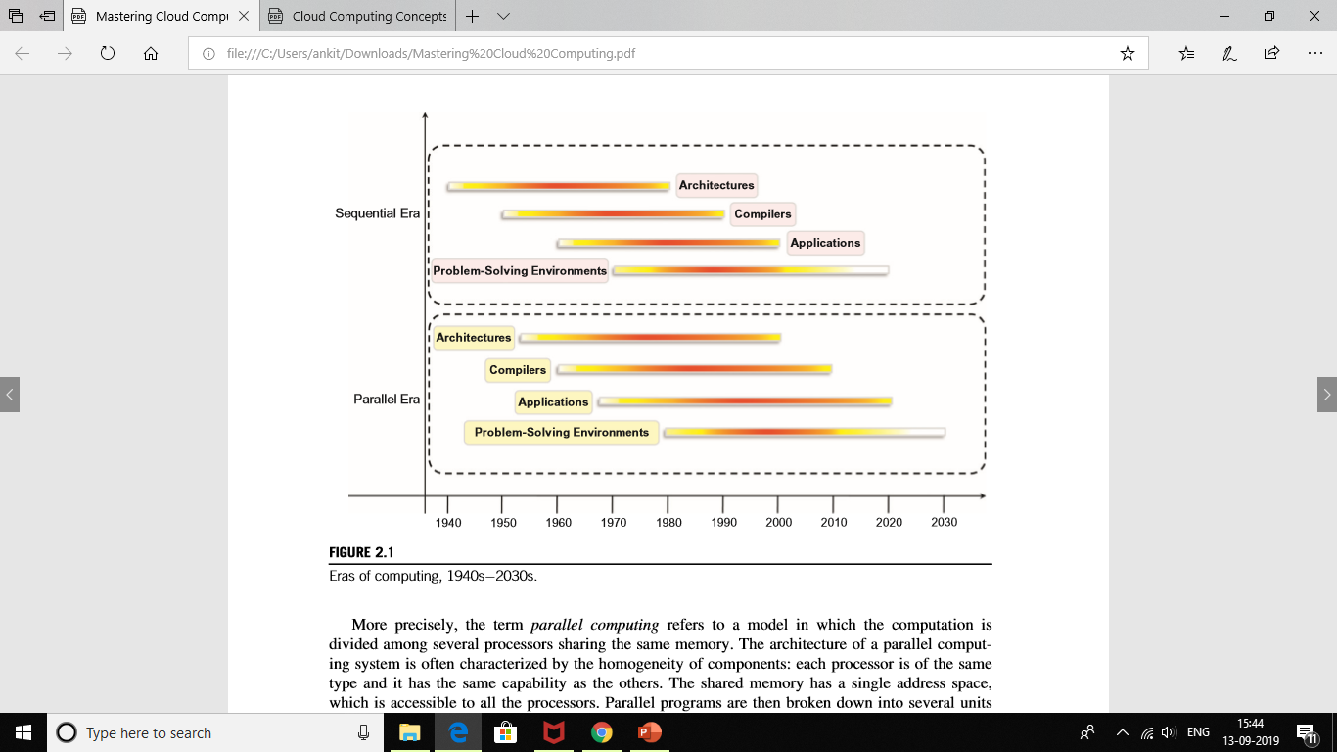
Eras of computing
The two fundamental and dominant models of computing are sequential and parallel. The sequential computing era began in the 1940s; the parallel (and distributed) computing era followed it within a decade (see Figure 2.1). The four key elements of computing developed during these eras are architectures, compilers, applications, and problem-solving environments.

Slide 22
Parallel vs. distributed computing
The terms parallel computing and distributed computing are often used interchangeably, even though they mean slightly different things. The term parallel implies a tightly coupled system, whereas distributed refers to a wider class of system, including those that are tightly coupled.
The term distributed computing encompasses any architecture or system that allows the computation to be broken down into units and executed concurrently on different computing elements, whether these are processors on different nodes, processors on the same computer, or cores within the same processor.

Slide 23
Elements of parallel computing
It is now clear that silicon-based processor chips are reaching their physical limits. Processing speed is constrained by the speed of light, and the density of transistors packaged in a processor is constrained by thermodynamic limitations. A viable solution to overcome this limitation is to connect multiple processors working in coordination with each other to solve “Grand Challenge” problems. The first steps in this direction led to the development of parallel computing, which encompasses techniques, architectures, and systems for performing multiple activities in parallel. As we already discussed, the term parallel computing has blurred its edges with the term distributed computing and is often used in place of the latter term. In this section, we refer to its proper characterization, which involves the introduction of parallelism within a single computer by coordinating the activity of multiple processors together.

Slide 24
Hardware architectures for parallel processing
The core elements of parallel processing are CPUs. Based on the number of instruction and data streams that can be processed simultaneously, computing systems are classified into the following four categories:
• Single-instruction, single-data (SISD) systems
• Single-instruction, multiple-data (SIMD) systems
• Multiple-instruction, single-data (MISD) systems
• Multiple-instruction, multiple-data (MIMD) systems
2.3.2.1 Single-instruction, single-data (SISD) systems
An SISD computing system is a uniprocessor machine capable of executing a single instruction, which operates on a single data stream (see Figure 2.2). In SISD, machine instructions are processed sequentially; hence computers adopting this model are popularly called sequential computers. Most conventional computers are built using the SISD model. All the instructions and data to be processed have to be stored in primary memory. The speed of the processing element in the SISD model is limited by the rate at which the computer can transfer information internally. Dominant representative SISD systems are IBM PC, Macintosh, and workstations.

Slide 25
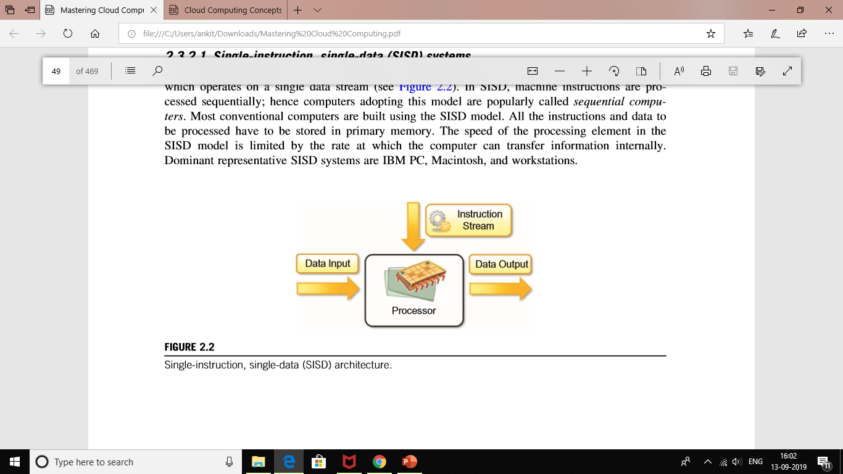

Slide 26
Single-instruction, multiple-data (SIMD) systems
An SIMD computing system is a multiprocessor machine capable of executing the same instruction on all the CPUs but operating on different data streams (see Figure 2.3). Machines based on an SIMD model are well suited to scientific computing since they involve lots of vector and matrix operations. For instance, statements such as Ci5AiBi can be passed to all the processing elements (PEs); organized data elements of vectors A and B can be divided into multiple sets (N-sets for N PE systems); and each PE can process one data set. Dominant representative SIMD systems are Cray’s vector processing machine and Thinking Machines’.

Slide 27
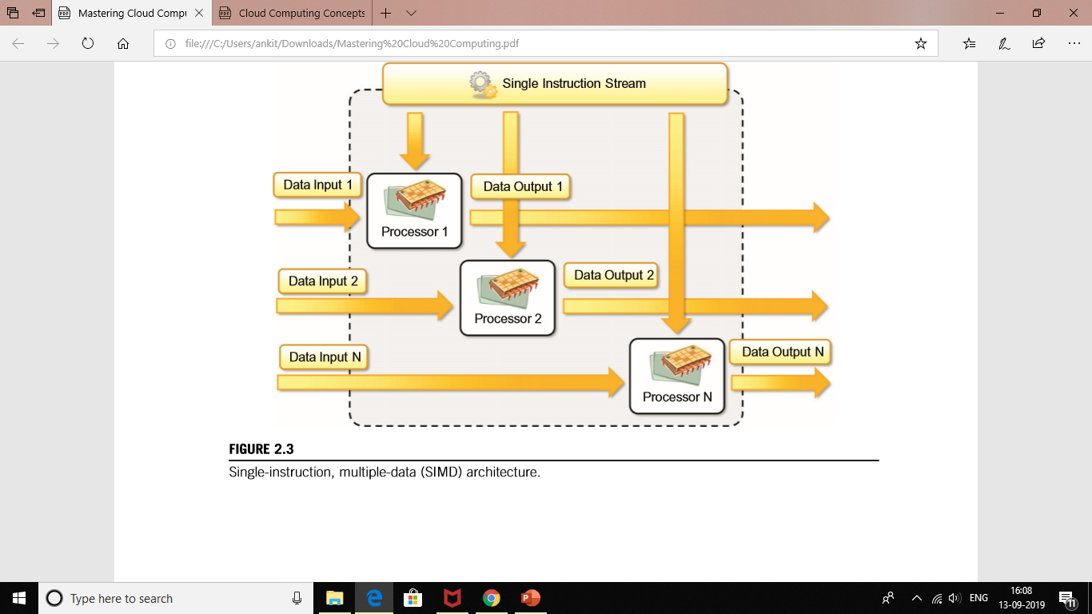

Slide 28
Multiple-instruction, single-data (MISD) systems
An MISD computing system is a multiprocessor machine capable of executing different instructions on different PEs but all of them operating on the same data set (see Figure 2.4). For instance, statements such as perform different operations on the same data set. Machines built using the MISD model are not useful in most of the applications; a few machines are built, but none of them are available commercially. They became more of an intellectual exercise than a practical configuration.

Slide 29
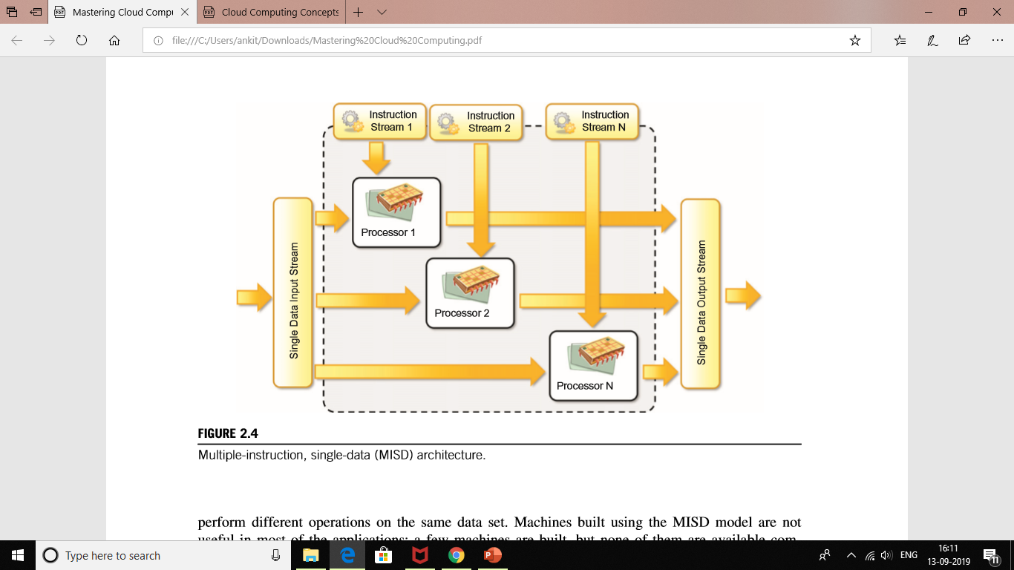

Slide 30
Multiple-instruction, multiple-data (MIMD) systems
An MIMD computing system is a multiprocessor machine capable of executing multiple instructions on multiple data sets (see Figure 2.5). Each PE in the MIMD model has separate instruction and data streams; hence machines built using this model are well suited to any kind of application. Unlike SIMD and MISD machines, PEs in MIMD machines work asynchronously. MIMD machines are broadly categorized into shared-memory MIMD and distributed-memory MIMD based on the way PEs are coupled to the main memory.
Shared memory MIMD machines
In the shared memory MIMD model, all the PEs are connected to a single global memory and they all have access to it (see Figure 2.6). Systems based on this model are also called tightly coupled multiprocessor systems. The communication between PEs in this model takes place through the shared memory; modification of the data stored in the global memory by one PE is visible to all other PEs. Dominant representative shared memory MIMD systems are Silicon Graphics machines and Sun/IBM’s SMP (Symmetric Multi-Processing).

Slide 31
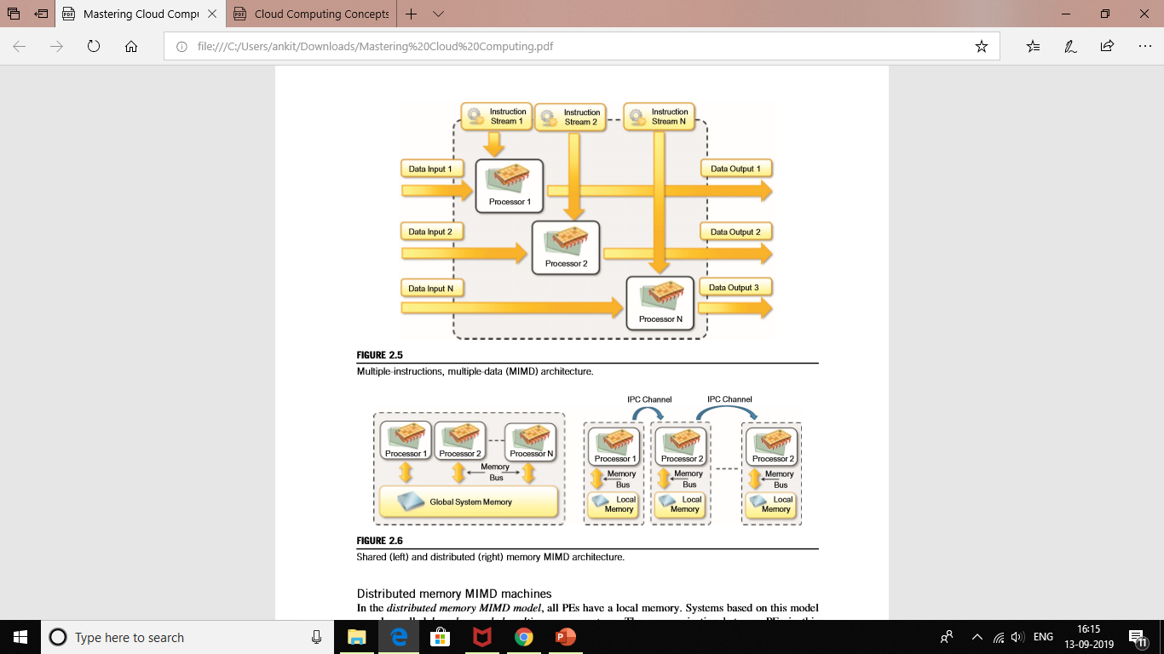

Slide 32
Distributed memory MIMD machines
In the distributed memory MIMD model, all PEs have a local memory. Systems based on this model are also called loosely coupled multiprocessor systems. The communication between PEs in this model takes place through the interconnection network (the interprocess communication channel, or IPC). The network connecting PEs can be configured to tree, mesh, cube, and so on. Each PE operates asynchronously, and if communication/synchronization among tasks is necessary, they can do so by exchanging messages between them.

Slide 33
LEVELS OF PARALLELISM
Large grain (or task level)
Medium grain (or control level)
Fine grain (data level)
Very fine grain (multiple-instruction issue)

Slide 34
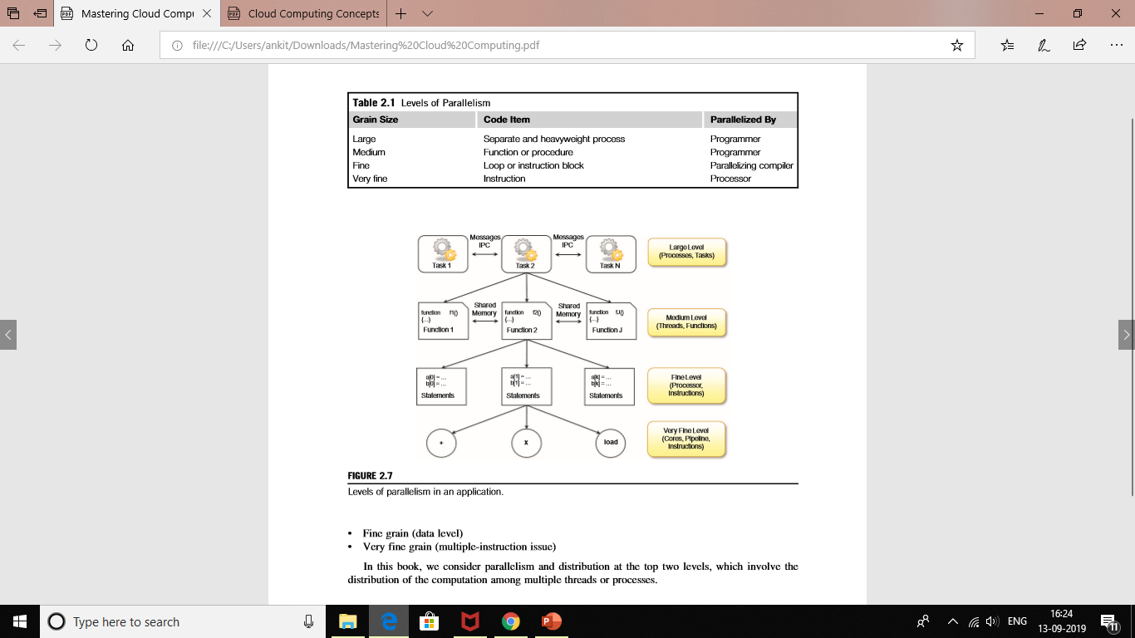

Slide 35
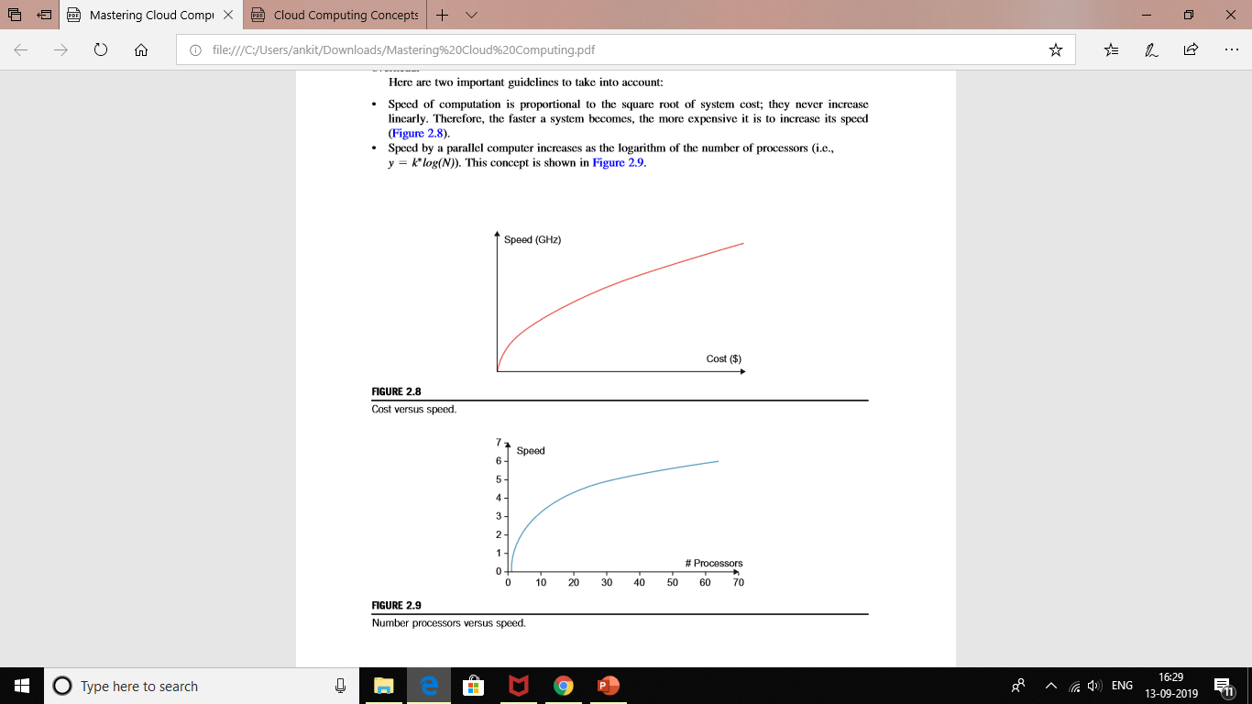
Laws of caution

Slide 36
Elements of distributed computing
In the previous section, we discussed techniques and architectures that allow introduction of parallelism within a single machine or system and how parallelism operates at different levels of the computing stack. In this section, we extend these concepts and explore how multiple activities can be performed by leveraging systems composed of multiple heterogeneous machines and systems. We discuss what is generally referred to as distributed computing and more precisely introduce the most common guidelines and patterns for implementing distributed computing systems from the perspective of the software designer.
General concepts and definitions
Distributed computing studies the models, architectures, and algorithms used for building and managing distributed systems.

Slide 37
A distributed system is a collection of independent computers that appears to its users as a single coherent system.
A distributed system is one in which components located at networked computers communicate and coordinate their actions only by passing messages.
As specified in this definition, the components of a distributed system communicate with some sort of message passing. This is a term that encompasses several communication models.

Slide 38
Components of a distributed system
A distributed system is the result of the interaction of several components that traverse the entire computing stack from hardware to software. It emerges from the collaboration of several elements that by working together give users the illusion of a single coherent system. Figure 2.10 provides an overview of the different layers that are involved in providing the services of a distributed system.

Slide 39
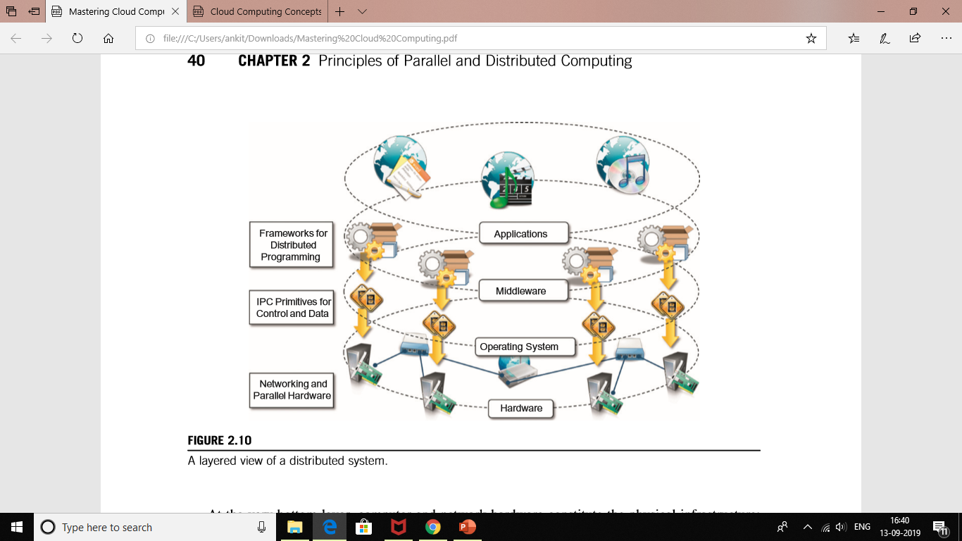

Slide 40
A very good example is constituted by Infrastructure-as-a-Service (IaaS) providers such as Amazon Web Services (AWS), which provide facilities for creating virtual machines, organizing them together into a cluster, and deploying applications and systems on top. Figure 2.11 shows an example of how the general reference architecture of a distributed system is contextualized in the case of a cloud computing system.

Slide 41
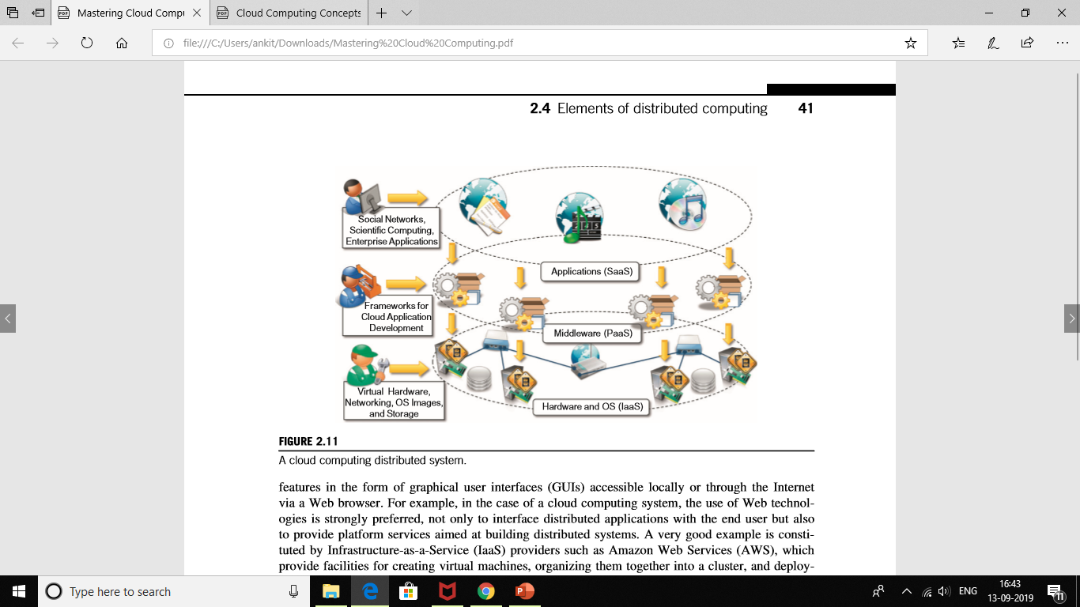

Slide 42
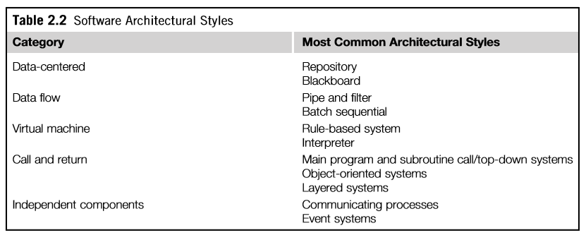
Software architectural styles
are classified as shown in Table 2.2.

Slide 43
The blackboard architectural style is characterized by three main components:
• Knowledge sources. These are the entities that update the knowledge base that is maintained in the blackboard.
• Blackboard. This represents the data structure that is shared among the knowledge sources and stores the knowledge base of the application.
• Control. The control is the collection of triggers and procedures that govern the interaction with the blackboard and update the status of the knowledge base.
Data-flow architectures
Batch Sequential Style : -The batch sequential style is characterized by an ordered sequence of separate programs executing one after the other.
Pipe-and-Filter Style. The pipe-and-filter style is a variation of the previous style for expressing the activity of a software system as sequence of data transformations.
Another example are the Unix shell pipes (i.e., cat ,filename.j grep,pattern.j wc l), where the filters are the single shell programs composed together and the connections are their input and output streams that are chained together.

Slide 44
Rule-Based Style : - This architecture is characterized by representing the abstract execution environment as an inference engine.
Interpreter Style:- The core feature of the interpreter style is the presence of an engine that is used to interpret a pseudo-program expressed in a format acceptable for the interpreter.
Top-Down Style:- This architectural style is quite representative of systems developed with imperative programming, which leads to a divide-and-conquer approach to problem resolution. Systems developed according to this style are composed of one large main program that accomplishes its tasks by invoking subprograms or procedures.
Object-Oriented Style :- This architectural style encompasses a wide range of systems that have been designed and implemented by leveraging the abstractions of object-oriented programming (OOP).
Layered Style :- The layered system style allows the design and implementation of software systems in terms of layers, which provide a different level of abstraction of the system.

Slide 45
System architectural styles
System architectural styles cover the physical organization of components and processes over a distributed infrastructure. They provide a set of reference models for the deployment of such systems and help engineers not only have a common vocabulary in describing the physical layout of systems but also quickly identify the major advantages and drawbacks of a given deployment and whether it is applicable for a specific class of applications. In this section, we introduce two fundamental reference styles: client/server and peer-to-peer.
Client/server This architecture is very popular in distributed computing and is suitable for a wide variety of applications. As depicted in Figure 2.12, the client/server model features two major components: a server and a client. These two components interact with each other through a network connection using a given protocol. The communication is unidirectional: The client issues a request to the server, and after processing the request the server returns a response. There could be multiple client components issuing requests to a server that is passively waiting for them. Hence, the important operations in the client-server paradigm are request, accept (client side), and listen and response (server side).

Slide 46
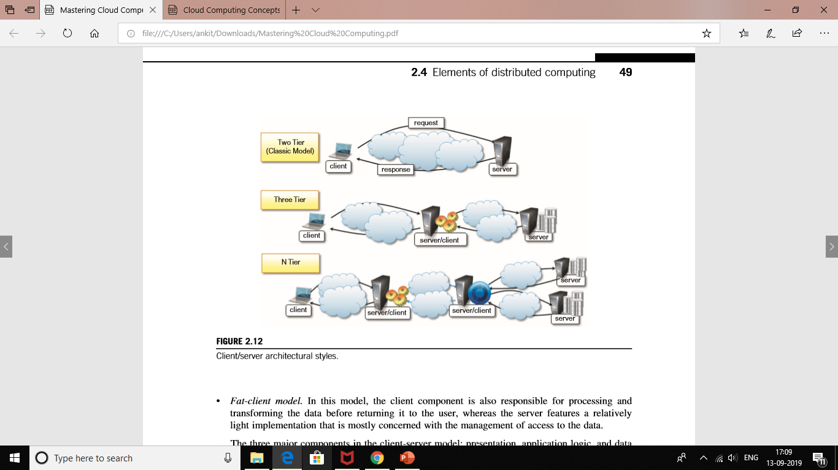

Slide 47
Thin-client model : - In this model, the load of data processing and transformation is put on the server side, and the client has a light implementation that is mostly concerned with retrieving and returning the data it is being asked for, with no considerable further processing.
Fat-client model :- In this model, the client component is also responsible for processing and transforming the data before returning it to the user, whereas the server features a relatively light implementation that is mostly concerned with the management of access to the data.

Slide 48
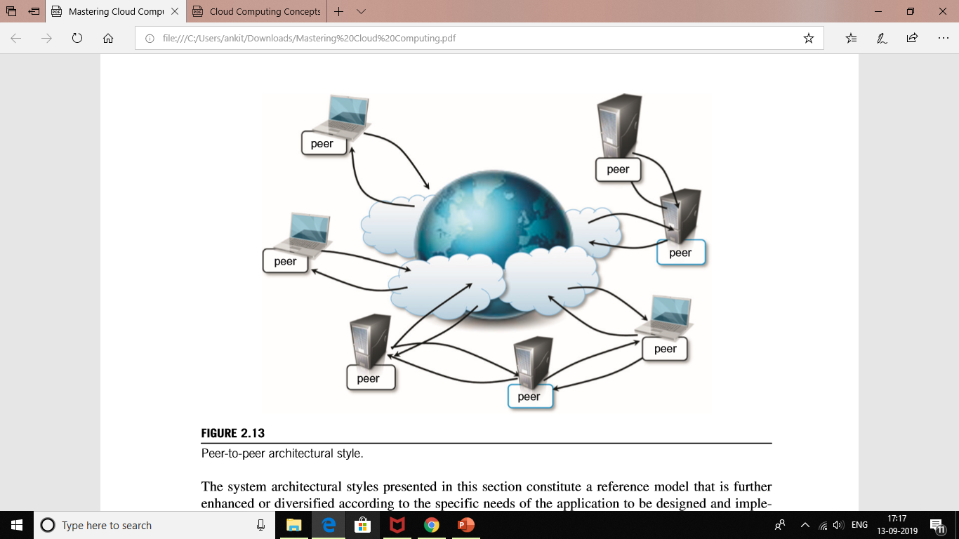

Slide 49
MODELS FOR INTERPROCESS COMMUNICATION
Message-based communication:
Message passing. This paradigm introduces the concept of a message as the main abstraction of the model. The entities exchanging information explicitly encode in the form of a message the data to be exchanged. The structure and the content of a message vary according to the model. Examples of this model are the Message-Passing Interface (MPI) and OpenMP.
• Remote procedure call (RPC). This paradigm extends the concept of procedure call beyond the boundaries of a single process, thus triggering the execution of code in remote process.

Slide 50
Models For Message-based Communication
Point-to-point message model :- This model organizes the communication among single components. Each message is sent from one component to another, and there is a direct addressing to identify the message receiver.
Publish-and-subscribe message model :- This model introduces a different strategy, one that is based on notification among components. There are two major roles: the publisher and the subscriber.

Slide 51
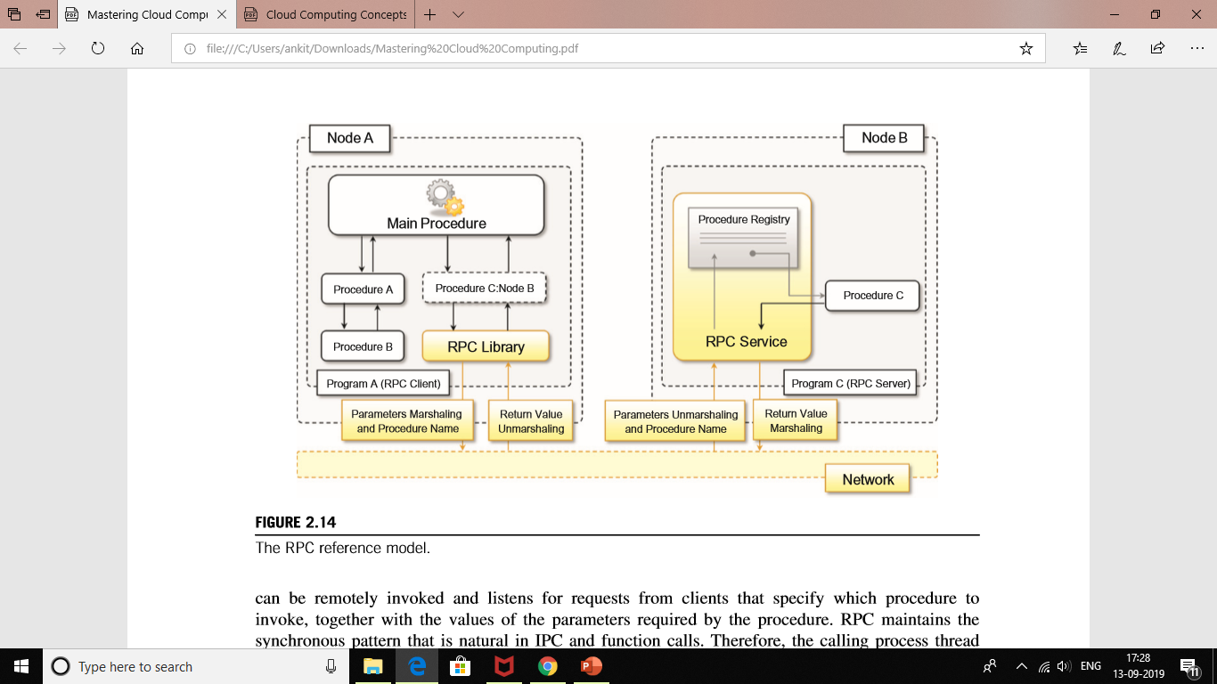
TECHNOLOGIES FOR DISTRIBUTED COMPUTING
Remote procedure call

Slide 52
DISTRIBUTED OBJECT FRAMEWORKS
With respect to the RPC model, the infrastructure manages instances that are exposed through wellknown interfaces instead of procedures. Therefore, the common interaction pattern is the following:
The server process maintains a registry of active objects that are made available to other processes. According to the specific implementation, active objects can be published using interface definitions or class definitions.
The client process, by using a given addressing scheme, obtains a reference to the active remote object. This reference is represented by a pointer to an instance that is of a shared type of interface and class definition.
The client process invokes the methods on the active object by calling them through the reference previously obtained. Parameters and return values are marshaled as happens in the case of RPC.
Figure 2.15 gives an overview of how this infrastructure works.

Slide 53
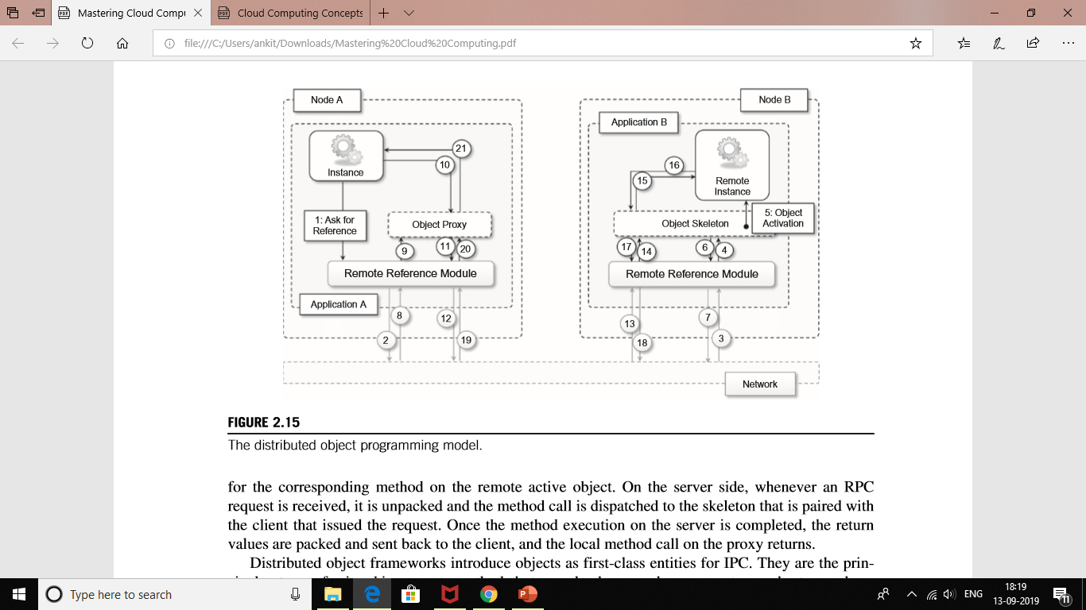

Slide 54
SERVICE-ORIENTED COMPUTING
Service-oriented computing organizes distributed systems in terms of services, which represent the major abstraction for building systems. Service orientation expresses applications and software systems as aggregations of services that are coordinated within a service-oriented architecture(SOA).
What is a service?
A service encapsulates a software component that provides a set of coherent and related functionalities that can be reused and integrated into bigger and more complex architecture.

Slide 55
SERVICE-ORIENTED ARCHITECTURE (SOA)
There are two major roles within SOA: the service provider and the service consumer.
Standardized service contract. Services adhere to a given communication agreement, which is specified through one or more service description documents.
• Loose coupling: Services are designed as self-contained components, maintain relationships that minimize dependencies on other services, and only require being aware of each other. Service contracts will enforce the required interaction among services. This simplifies the flexible aggregation of services and enables a more agile design strategy that supports the evolution of the enterprise business.
• Abstraction: A service is completely defined by service contracts and description documents. They hide their logic, which is encapsulated within their implementation.

Slide 56
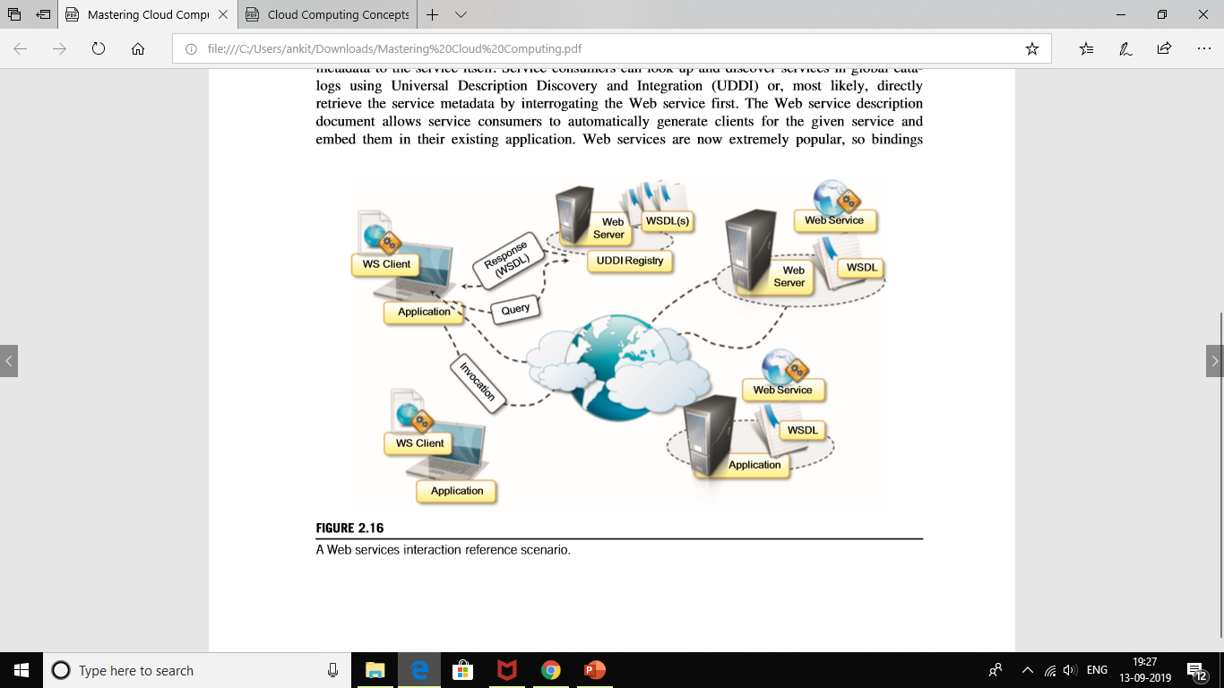
Web services
Web services are made accessible by being hosted in a Web server; therefore, HTTP is the most popular transport protocol used for interacting with Web services. Figure 2.16 describes the common-use case scenarios for Web services.

Slide 57
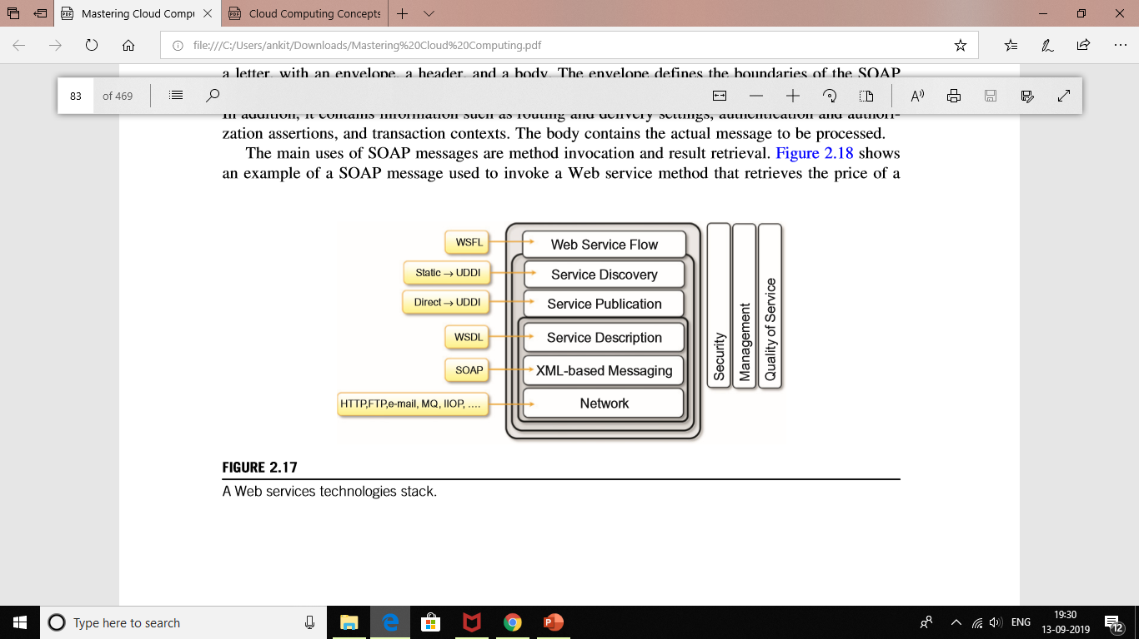
Figure 2.17 shows the Web service technologies stack that lists all the components of the conceptual framework describing and enabling the Web services abstraction.

Slide 58
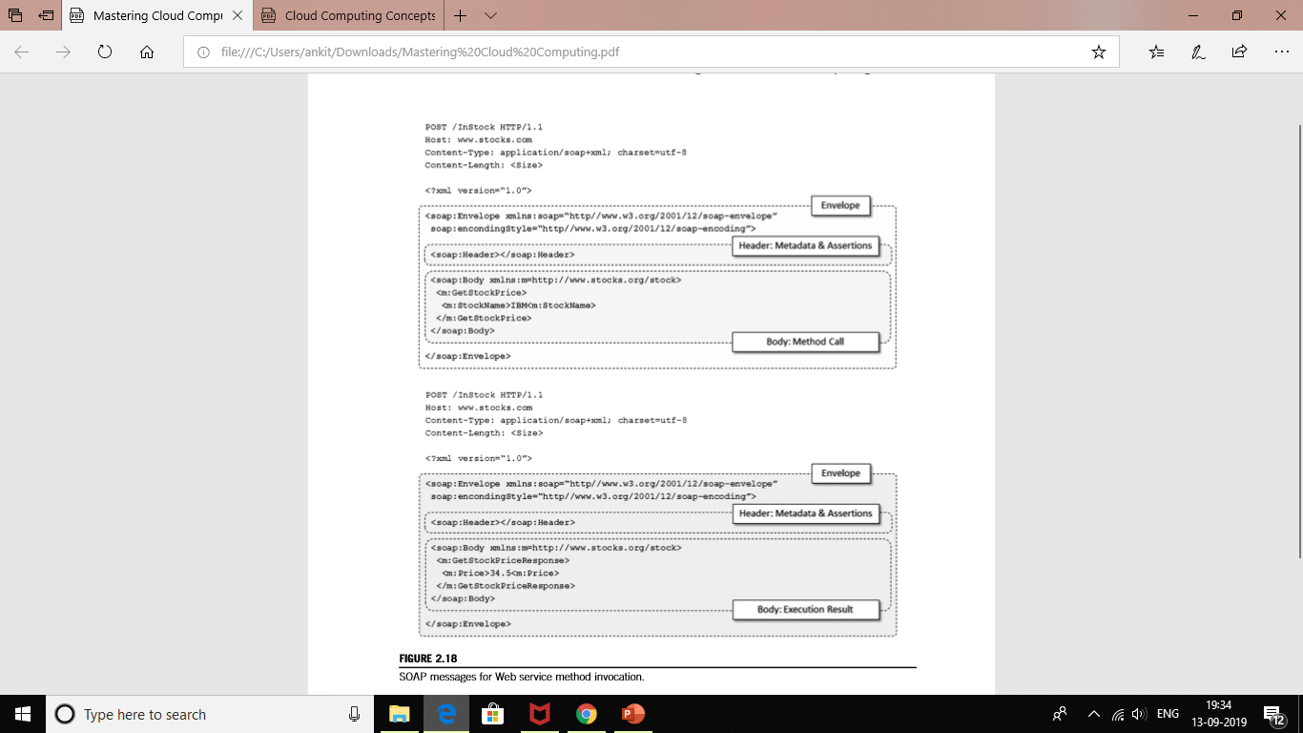
The main uses of SOAP messages are method invocation and result retrieval. Figure 2.18 shows an example of a SOAP message used to invoke a Web service method that retrieves the price of a given stock and the corresponding reply.

Slide 59
CHAPTER 3 VIRTUALIZATION
Introduction Virtualization is a large umbrella of technologies and concepts that are meant to provide an abstract environment—whether virtual hardware or an operating system—to run applications. The term virtualization is often synonymous with hardware virtualization, which plays a fundamental role in efficiently delivering Infrastructure-as-a-Service (IaaS) solutions foe cloud computing.
Increased performance and computing capacity.
Underutilized hardware and software resources.
Lack of space
Greening initiatives.
Rise of administrative costs

Slide 60
CHARACTERISTICS OF VIRTUALIZED ENVIRONMENTS
Virtualization is a broad concept that refers to the creation of a virtual version of something, whether hardware, a software environment, storage, or a network. In a virtualized environment there are three major components: guest, host, and virtualization layer. The guest represents the system component that interacts with the virtualization layer rather than with the host, as would normally happen. The host represents the original environment where the guest is supposed to be managed. The virtualization layer is responsible for recreating the same or a different environment where the guest will operate (see Figure 3.1).

Slide 61
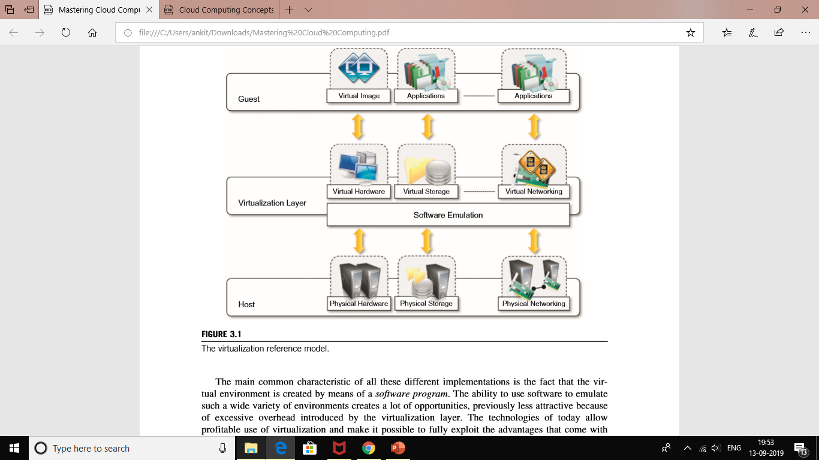

Slide 62
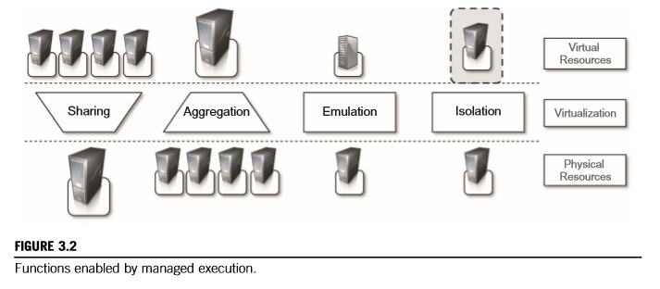
Increased security:- The ability to control the execution of a guest in a completely transparent manner opens new possibilities for delivering a secure, controlled execution environment. The virtual machine represents an emulated environment in which the guest is executed.

Slide 63
Managed execution:- Virtualization of the execution environment not only allows increased security, but a wider range of features also can be implemented. In particular, sharing, aggregation, emulation, and isolation are the most relevant features (see Figure 3.2).
Sharing :-Virtualization allows the creation of a separate computing environments within the same host.
Aggregation:- Not only is it possible to share physical resource among several guests, but virtualization also allows aggregation, which is the opposite process.
Emulation:- Guest programs are executed within an environment that is controlled by the virtualization layer, which ultimately is a program.
Isolation:- Virtualization allows providing guests—whether they are operating systems, applications, or other entities—with a completely separate environment, in which they are executed.

Slide 64
Portability:-
The concept of portability applies in different ways according to the specific type of virtualization considered. In the case of a hardware virtualization solution, the guest is packaged into a virtual image that, in most cases, can be safely moved and executed on top of different virtual machines. Except for the file size, this happens with the same simplicity with which we can display a picture image in different computers. Virtual images are generally proprietary formats that require a specific virtual machine manager to be executed. In the case of programming-level virtualization, as implemented by the JVM or the .NET runtime, the binary code representing application components (jars or assemblies) can be run without any recompilation on any implementation of the corresponding VM.

Slide 65
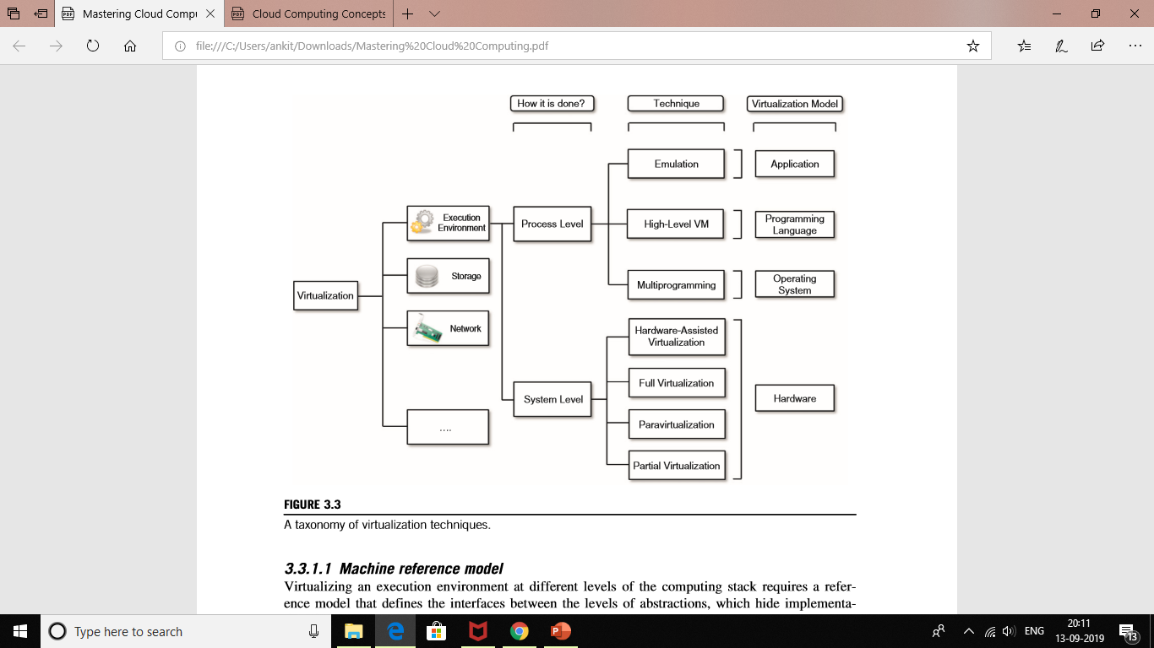
Taxonomy of virtualization techniques
Virtualization covers a wide range of emulation techniques that are applied to different areas of computing. A classification of these techniques helps us better understand their characteristics and use (see Figure 3.3).

Slide 66
Machine reference model
Virtualizing an execution environment at different levels of the computing stack requires a reference model that defines the interfaces between the levels of abstractions, which hide implementation details.
Modern computing systems can be expressed in terms of the reference model described in Figure 3.4. At the bottom layer, the model for the hardware is expressed in terms of the Instruction Set Architecture (ISA), which defines the instruction set for the processor, registers, memory, and interrupt management. ISA is the interface between hardware and software, and it is important to the operating system (OS) developer (System ISA) and developers of applications that directly manage the underlying hardware (User ISA).
For instance, a possible implementation features a hierarchy of privileges (see Figure 3.5) in the form of ring-based security: Ring 0, Ring 1, Ring 2, and Ring 3; Ring 0 is in the most privileged level and Ring 3 in the least privileged level. Ring 0 is used by the kernel of the OS, rings 1 and 2 are used by the OS-level services, and Ring 3 is used by the user. Recent systems support only two levels, with Ring 0 for supervisor mode and Ring 3 for user mode.

Slide 67
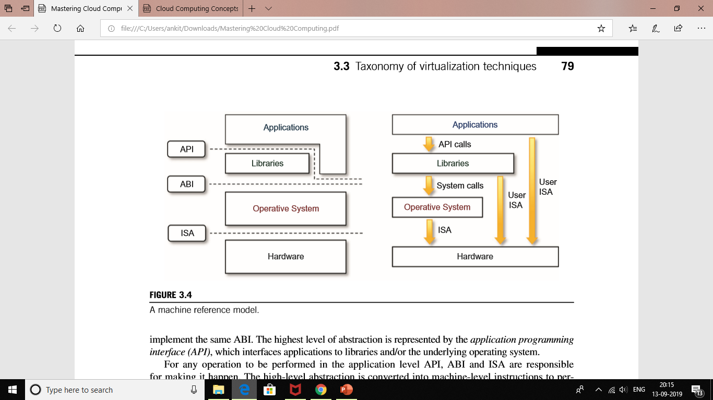

Slide 68
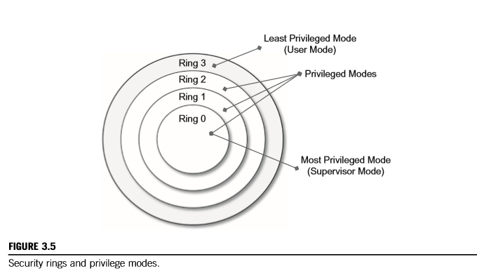

Slide 69
All the current systems support at least two different execution modes: supervisor mode and user mode. The first mode denotes an execution mode in which all the instructions (privileged and nonprivileged) can be executed without any restriction. This mode, also called master mode or kernel mode, is generally used by the operating system (or the hypervisor) to perform sensitive operations on hardware level resources. In user mode, there are restrictions to control the machine-level resources.

Slide 70
Hardware-level virtualization
Hardware-level virtualization is a virtualization technique that provides an abstract execution environment in terms of computer hardware on top of which a guest operating system can be run. In this model, the guest is represented by the operating system, the host by the physical computer hardware, the virtual machine by its emulation, and the virtual machine manager by the hypervisor (see Figure 3.6).
The hypervisor is generally a program or a combination of software and hardware that allows the abstraction of the underlying physical hardware. Hardware-level virtualization is also called system virtualization, since it provides ISA to virtual machines, which is the representation of the hardware interface of a system. This is to differentiate it from process virtual machines, which expose ABI to virtual machines.
Hypervisors A fundamental element of hardware virtualization is the hypervisor, or virtual machine manager (VMM). It recreates a hardware environment in which guest operating systems are installed.
There are two major types of hypervisor: Type I and Type II (see Figure 3.7).
• Type I hypervisors run directly on top of the hardware. Therefore, they take the place of the operating systems and interact directly with the ISA interface exposed by the underlying hardware, and they emulate this interface in order to allow the management of guest operating systems. This type of hypervisor is also called a native virtual machine since it runs natively on hardware.

Slide 71
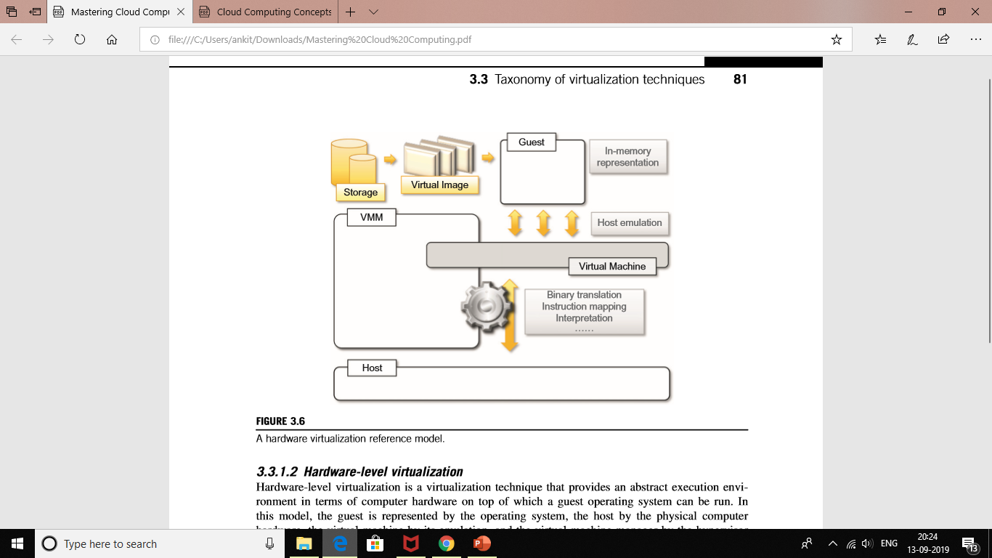

Slide 72
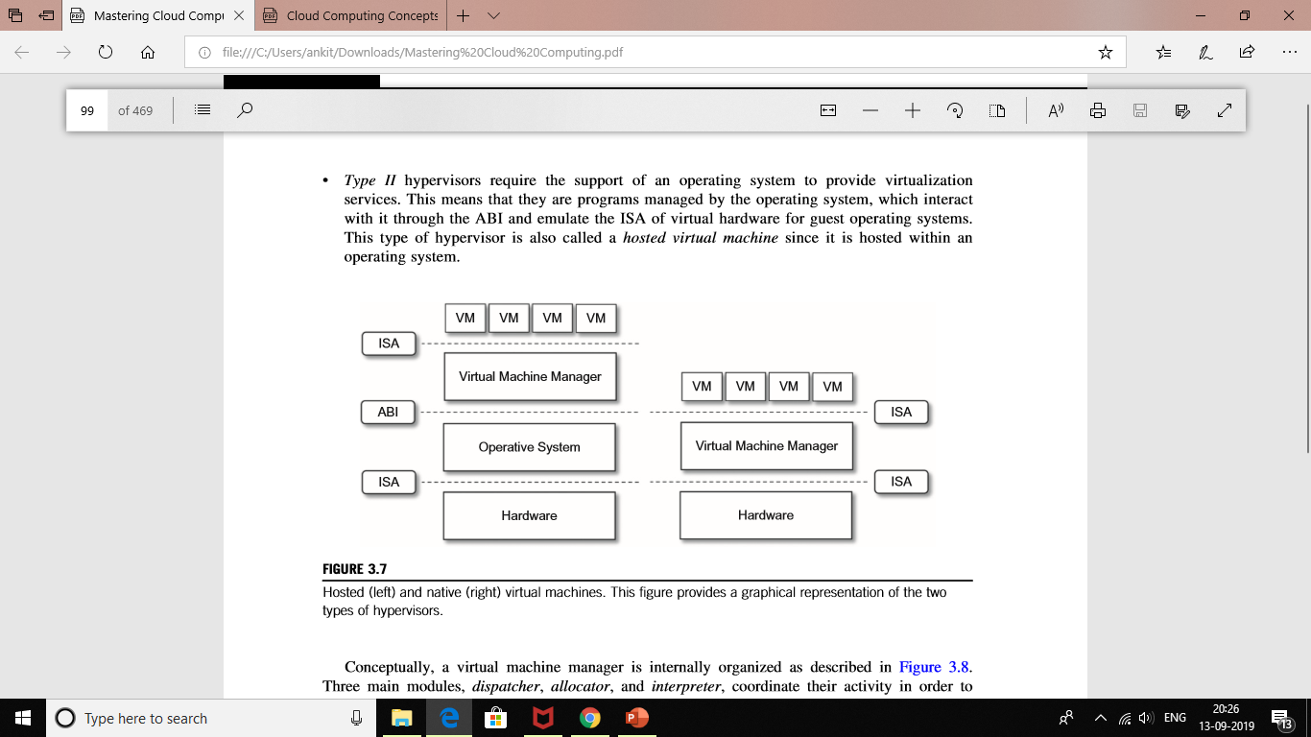
• Type II hypervisors require the support of an operating system to provide virtualization services. This means that they are programs managed by the operating system, which interact with it through the ABI and emulate the ISA of virtual hardware for guest operating systems. This type of hypervisor is also called a hosted virtual machine since it is hosted within an operating system.

Slide 73
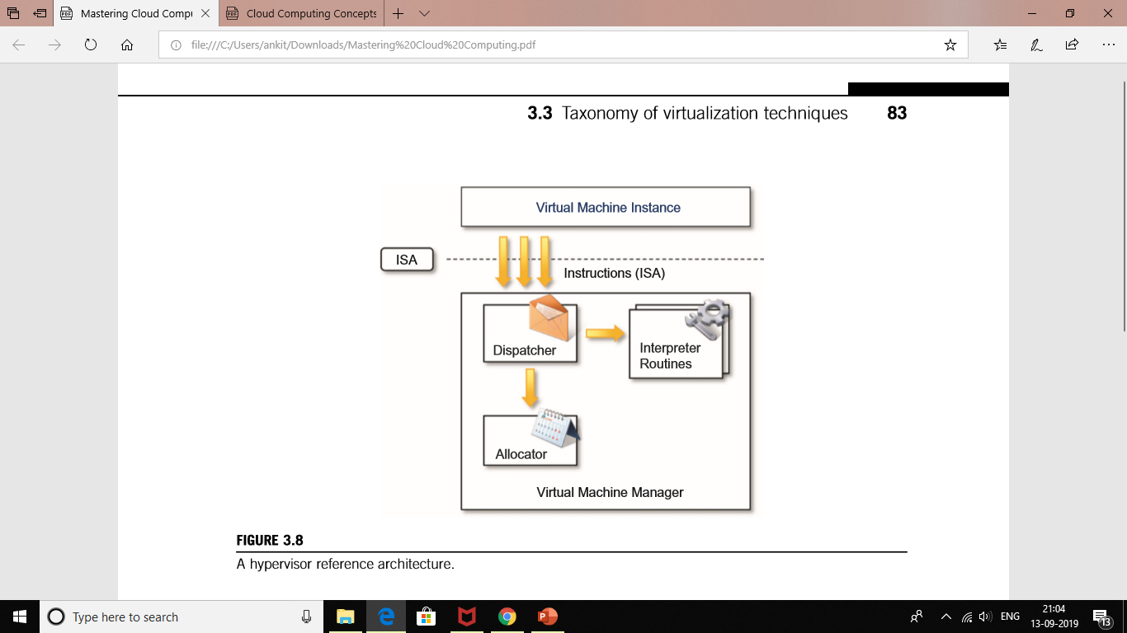
Conceptually, a virtual machine manager is internally organized as described in Figure 3.8.
Three main modules, dispatcher, allocator, and interpreter, coordinate their activity in order to emulate the underlying hardware.
Equivalence. A guest running under the control of a virtual machine manager should exhibit the same behavior as when it is executed directly on the physical host.
• Resource control. The virtual machine manager should be in complete control of virtualized resources.
• Efficiency. A statistically dominant fraction of the machine instructions should be executed without intervention from the virtual machine manager.

Slide 74
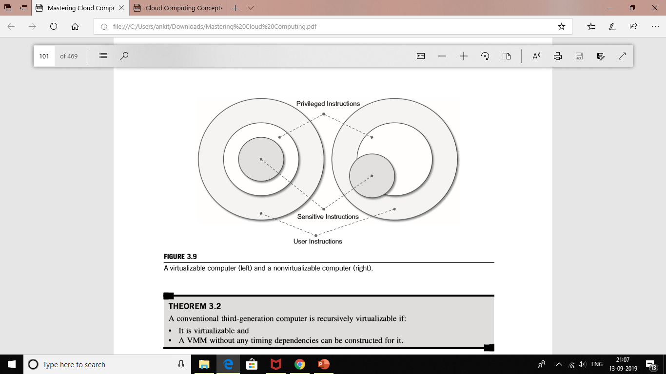
THEOREM 3.1 For any conventional third-generation computer, a VMM may be constructed if the set of sensitive instructions for that computer is a subset of the set of privileged instructions.
This theorem establishes that all the instructions that change the configuration of the system resources should generate a trap in user mode and be executed under the control of the virtual machine manager.

Slide 75
THEOREM 3.2 A conventional third-generation computer is recursively virtualizable if:
• It is virtualizable and
• A VMM without any timing dependencies can be constructed for it.
Recursive virtualization is the ability to run a virtual machine manager on top of another virtual machine manager. This allows nesting hypervisors as long as the capacity of the underlying resources can accommodate that. Virtualizable hardware is a prerequisite to recursive virtualization.
THEOREM 3.3 A hybrid VMM may be constructed for any conventional third-generation machine in which the set of user-sensitive instructions is a subset of the set of privileged instructions.
There is another term, hybrid virtual machine (HVM), which is less efficient than the virtual machine system. In the case of an HVM, more instructions are interpreted rather than being executed directly. All instructions in virtual supervisor mode are interpreted.

Slide 76
Programming language-level virtualization
Programming language-level virtualization is mostly used to achieve ease of deployment of applications, managed execution, and portability across different platforms and operating systems. It consists of a virtual machine executing the byte code of a program, which is the result of the compilation process. Compilers implemented and used this technology to produce a binary format representing the machine code for an abstract architecture. The characteristics of this architecture vary from implementation to implementation.
Application-level virtualization
Application-level virtualization is a technique allowing applications to be run in runtime environments that do not natively support all the features required by such applications. In this scenario, applications are not installed in the expected runtime environment but are run as though they were. In general, these techniques are mostly concerned with partial file systems, libraries, and operating system component emulation. Such emulation is performed by a thin layer—a program or an operating system component—that is in charge of executing the application.

Slide 77
Other types of virtualization
Other than execution virtualization, other types of virtualization provide an abstract environment to interact with. These mainly cover storage, networking, and client/server interaction.
Storage virtualization
Storage virtualization is a system administration practice that allows decoupling the physical organization of the hardware from its logical representation. Using this technique, users do not have to be worried about the specific location of their data, which can be identified using a logical path.
Network virtualization
Network virtualization combines hardware appliances and specific software for the creation and management of a virtual network. Network virtualization can aggregate different physical networks into a single logical network (external network virtualization) or provide network-like functionality to an operating system partition (internal network virtualization). The result of external network virtualization is generally a virtual LAN (VLAN).
Desktop virtualization
Desktop virtualization abstracts the desktop environment available on a personal computer in order to provide access to it using a client/server approach. Desktop virtualization provides the same outcome of hardware virtualization but serves a different purpose. Similarly to hardware virtualization, desktop virtualization makes accessible a different system as though it were natively installed on the host, but this system is remotely stored on a different host and accessed through a network connection.

Slide 78
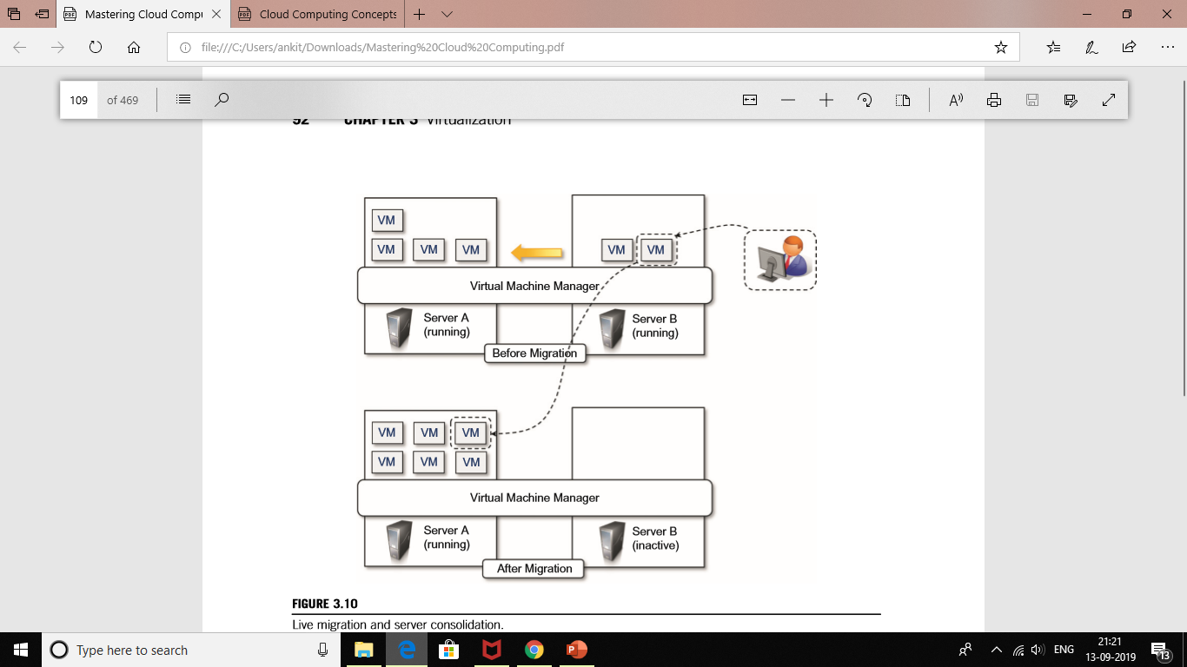
Virtualization and cloud computing
Virtualization plays an important role in cloud computing since it allows for the appropriate degree of customization, security, isolation, and manageability that are fundamental for delivering IT services on demand. Virtualization technologies are primarily used to offer configurable computing environments and storage. Network virtualization is less popular and, in most cases, is a complementary feature, which is naturally needed in build virtual computing systems.
rces by aggregating virtual machines over a smaller number of resources that become fully utilized. This practice is also known as server consolidation, while the movement of virtual machine instances is called virtual machine migration (see Figure 3.10).

Slide 79
Pros and cons of virtualization
Virtualization has now become extremely popular and widely used, especially in cloud computing. The primary reason for its wide success is the elimination of technology barriers that prevented virtualization from being an effective and viable solution in the past. The most relevant barrier has been performance. Today, the capillary diffusion of the Internet connection and the advancements in computing technology have made virtualization an interesting opportunity to deliver on-demand IT infrastructure and services. Despite its renewed popularity, this technology has benefits and also drawbacks.
Advantages of virtualization
Managed execution and isolation are perhaps the most important advantages of virtualization. In the case of techniques supporting the creation of virtualized execution environments, these two characteristics allow building secure and controllable computing environments. A virtual execution environment can be configured as a sandbox, thus preventing any harmful operation to cross the borders of the virtual host. Moreover, allocation of resources and their partitioning among different guests is simplified, being the virtual host controlled by a program. This enables fine-tuning of resources, which is very important in a server consolidation scenario and is also a requirement for effective quality of service.

Slide 80
The other side of the coin: disadvantages Virtualization also has downsides.
The most evident is represented by a performance decrease of guest systems as a result of the intermediation performed by the virtualization layer. In addition, suboptimal use of the host because of the abstraction layer introduced by virtualization management software can lead to a very inefficient utilization of the host or a degraded user experience. Less evident, but perhaps more dangerous, are the implications for security, which are mostly due to the ability to emulate a different execution environment.
Performance degradation
Performance is definitely one of the major concerns in using virtualization technology. Since virtualization interposes an abstraction layer between the guest and the host, the guest can experience increased latencies. For instance, in the case of hardware virtualization, where the intermediate emulates a bare machine on top of which an entire system can be installed, the causes of performance degradation can be traced back to the overhead introduced by the following activities:
• Maintaining the status of virtual processors
• Support of privileged instructions (trap and simulate privileged instructions)
• Support of paging within VM
• Console functions

Slide 81
Technology examples
A wide range of virtualization technology is available especially for virtualizing computing environments. In this section, we discuss the most relevant technologies and approaches utilized in the field. Cloud-specific solutions are discussed in the next chapter Technology examples A wide range of virtualization technology is available especially for virtualizing computing environments. In this section, we discuss the most relevant technologies and approaches utilized in the field. Cloud-specific solutions are discussed in the next chapter.
Xen: paravirtualization
Xen is an open-source initiative implementing a virtualization platform based on paravirtualization. Initially developed by a group of researchers at the University of Cambridge in the United Kingdom, Xen now has a large open-source community backing it. Citrix also offers it as a commercial solution, XenSource. Xen-based technology is used for either desktop virtualization or server virtualization, and recently it has also been used to provide cloud computing solutions by means of Xen Cloud Platform (XCP).

Slide 82
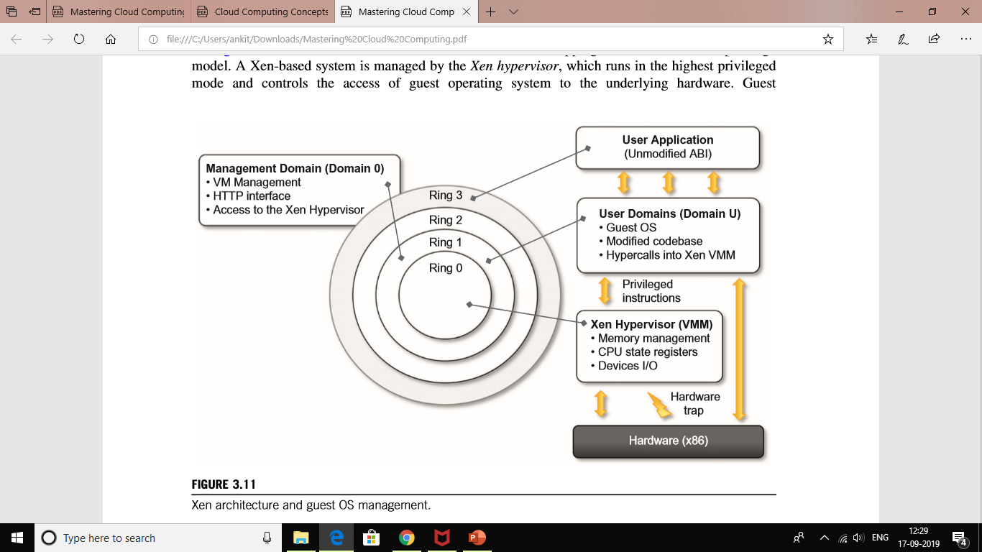
Figure 3.11 describes the architecture of Xen and its mapping onto a classic x86 privilege model. A Xen-based system is managed by the Xen hypervisor, which runs in the highest privileged mode and controls the access of guest operating system to the underlying hardware.

Slide 83
VMware: full virtualization
VMware’s technology is based on the concept of full virtualization, where the underlying hardware is replicated and made available to the guest operating system, which runs unaware of such abstraction layers and does not need to be modified. VMware implements full virtualization either in the desktop environment, by means of TYPE II or in the server environment, by means of TYPE I hypervisors.
In both cases, full virtualization is made possible by means of direct execution (for nonsensitive instructions) and binary translation (for sensitive instructions), thus allowing the virtualization of architecture such as x86.

Slide 84
Full virtualization and binary translation
VMware is well known for the capability to virtualize x86 architectures, which runs unmodified on top of their hypervisors. With the new generation of hardware architectures and the introduction of hardware-assisted virtualization (Intel VT-x and AMD V) in 2006, full virtualization is made possible with hardware support, but before that date, the use of dynamic binary translation was the only solution that allowed running x86 guest operating systems unmodified in a virtualized environment.
Moreover, to improve performance, the equivalent set of instruction is cached so that translation is no longer necessary for further occurrences of the same instructions.
Figure 3.12 gives an idea of the process.

Slide 85
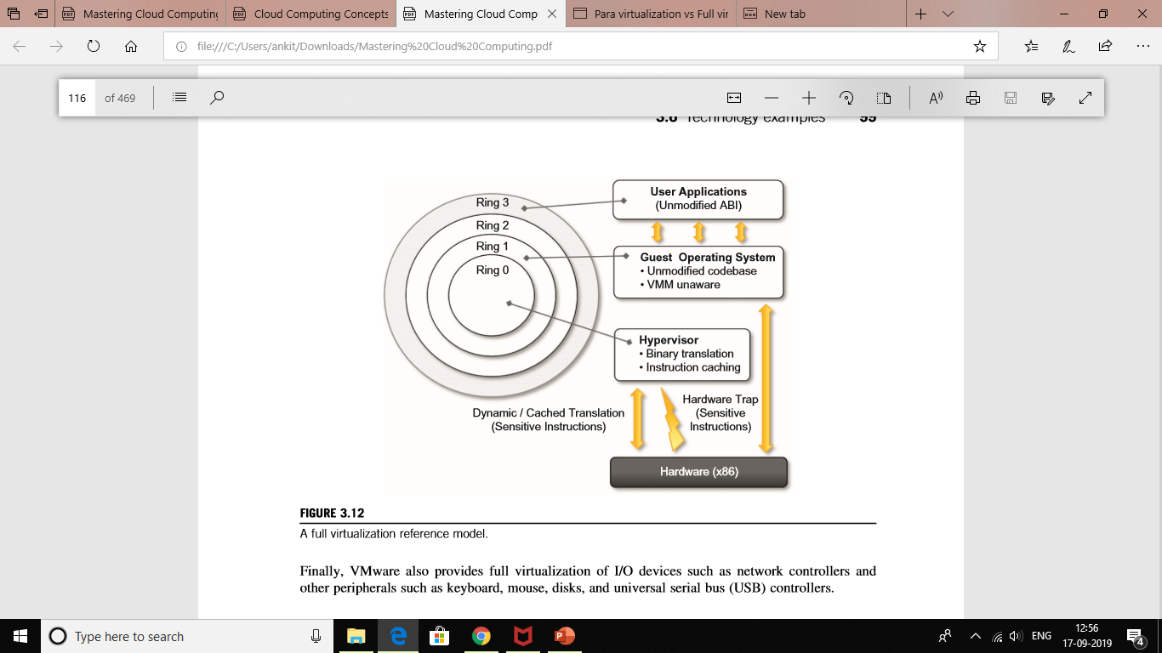

Slide 86
Virtualization solutions
VMware is a pioneer in virtualization technology and offers a collection of virtualization solutions covering the entire range of the market, from desktop computing to enterprise computing and infrastructure virtualization.
End-user (desktop) virtualization VMware supports virtualization of operating system environments and single applications on end user computers. Specific VMware software—VMware Workstation, for Windows operating systems, and VMware Fusion, for Mac OS X environments—is installed in the host operating system to create virtual machines and manage their execution.
Figure 3.13 provides an overview of the architecture in this system.
This is done by installing a specific driver in the host operating system that provides two main services:
• It deploys a virtual machine manager that can run in privileged mode.
• It provides hooks for the VMware application to process specific I/O requests eventually by relaying such requests to the host operating system via system calls.

Slide 87
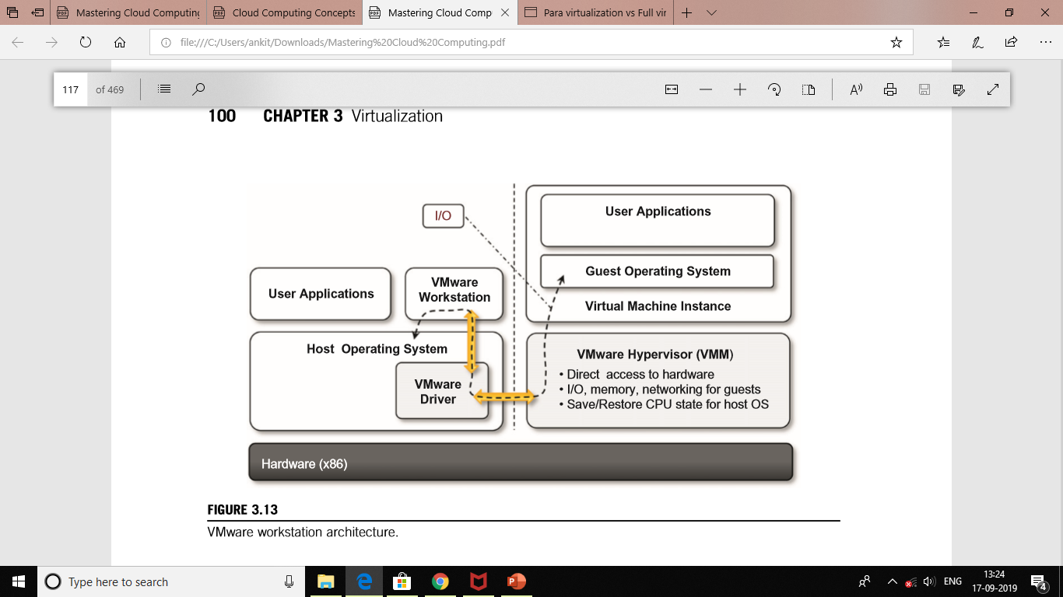

Slide 88
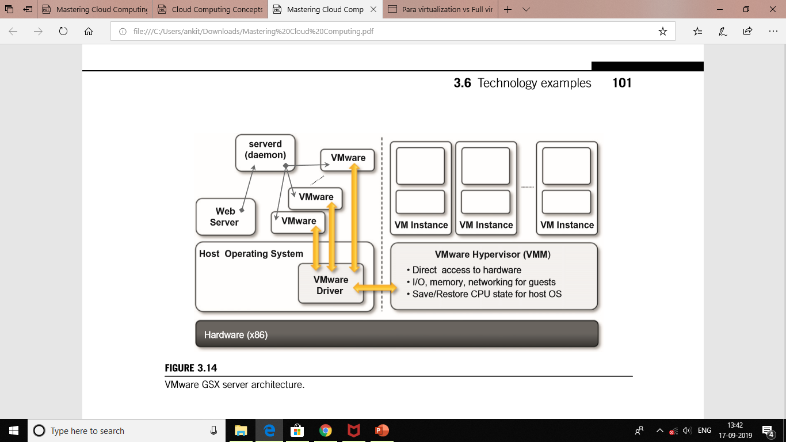
Server virtualization
VMware provided solutions for server virtualization with different approaches over time. Initial support for server virtualization was provided by VMware GSX server, which replicates the approach used for end-user computers and introduces remote management and scripting capabilities. The architecture of VMware GSX Server is depicted in Figure 3.14.

Slide 89
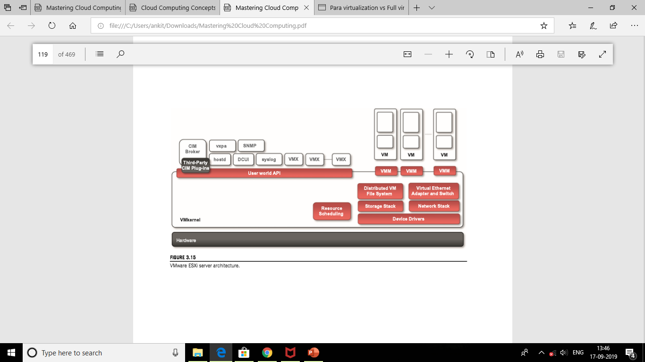
The architecture of VMware ESXi is displayed in Figure 3.15. The base of the infrastructure is the VMkernel, which is a thin Portable Operating System Interface (POSIX) compliant operating system that provides the minimal functionality for processes and thread management, file system, I/O stacks, and resource scheduling.

Slide 90
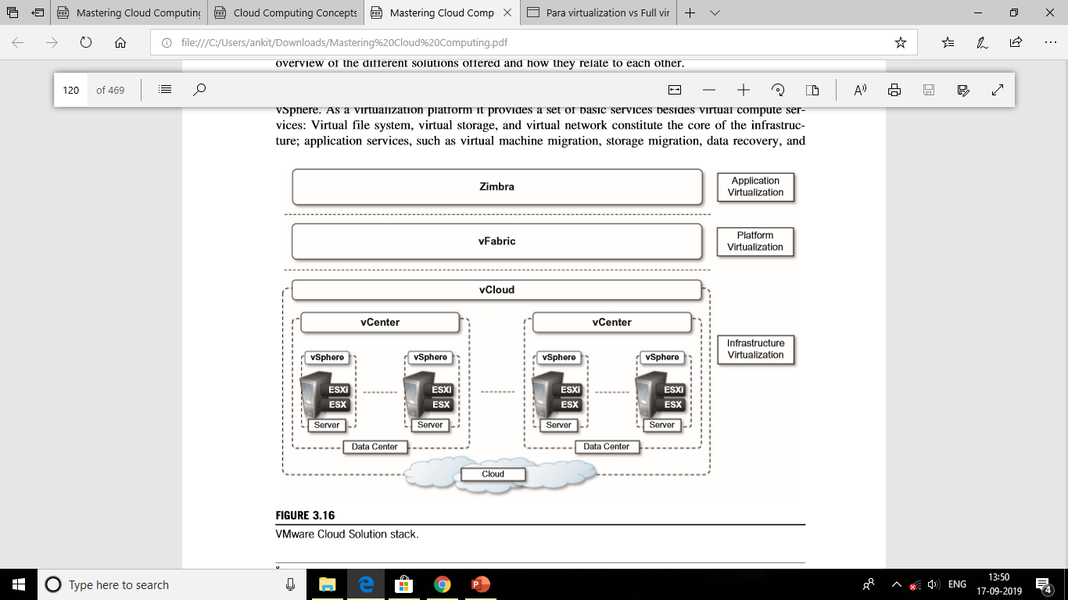
Infrastructure virtualization and cloud computing solutions
VMware provides a set of products covering the entire stack of cloud computing, from infrastructure management to Software-as-a-Service solutions hosted in the cloud. Figure 3.16 gives an overview of the different solutions offered and how they relate to each other. ESXi –enterprise –class type 1 hypervisor.

Slide 91
Microsoft Hyper-V
Hyper-V is an infrastructure virtualization solution developed by Microsoft for server virtualization.
As the name recalls, it uses a hypervisor-based approach to hardware virtualization, which leverages several techniques to support a variety of guest operating systems.
Hyper-V is currently shipped as a component of Windows Server 2008 R2 that installs the hypervisor as a role within the server.
3.6.3.1 Architecture Hyper-V supports multiple and concurrent execution of guest operating systems by means of partitions. A partition is a completely isolated environment in which an operating system is installed and run. Figure 3.17 provides an overview of the architecture of Hyper-V.

Slide 92
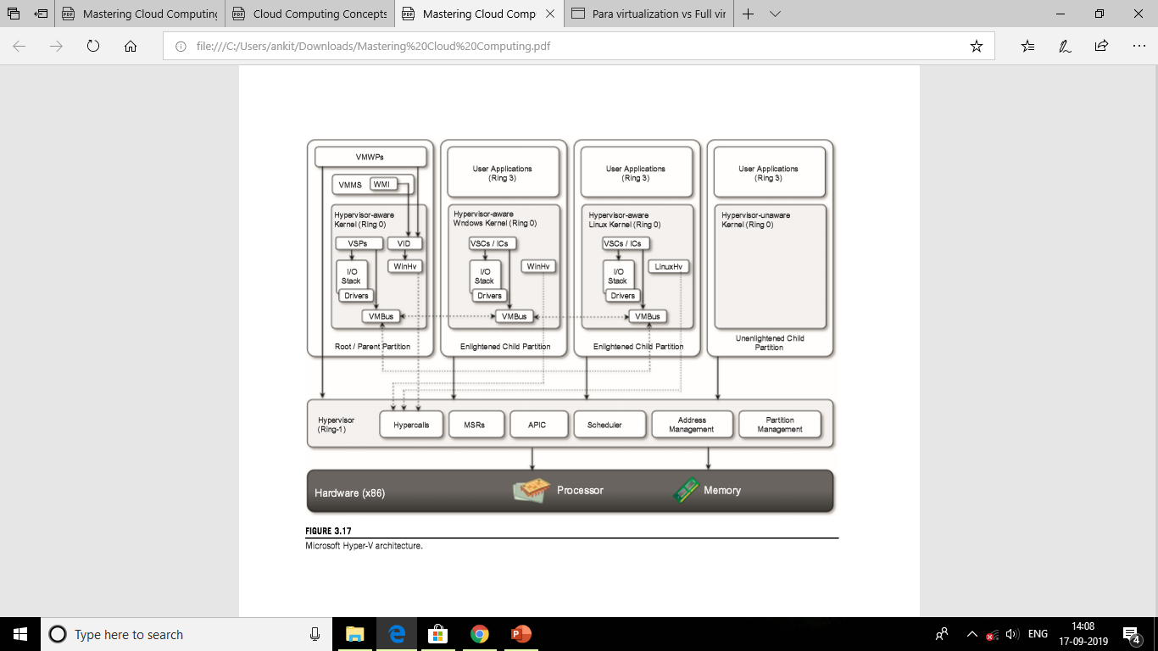

Slide 93
End of unit 1…..

